Slide 1
Public Speaking
With Professor Collier
Introduction to Public Speaking

Slide 2
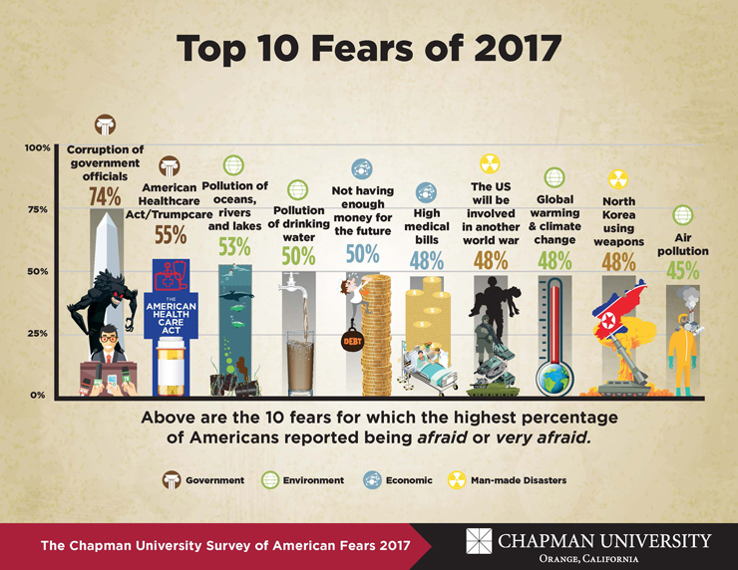
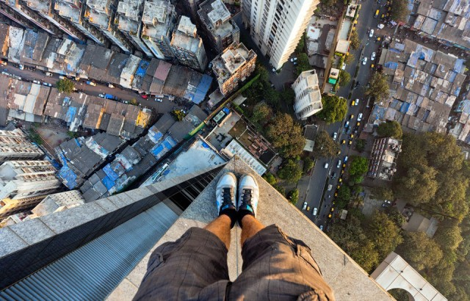
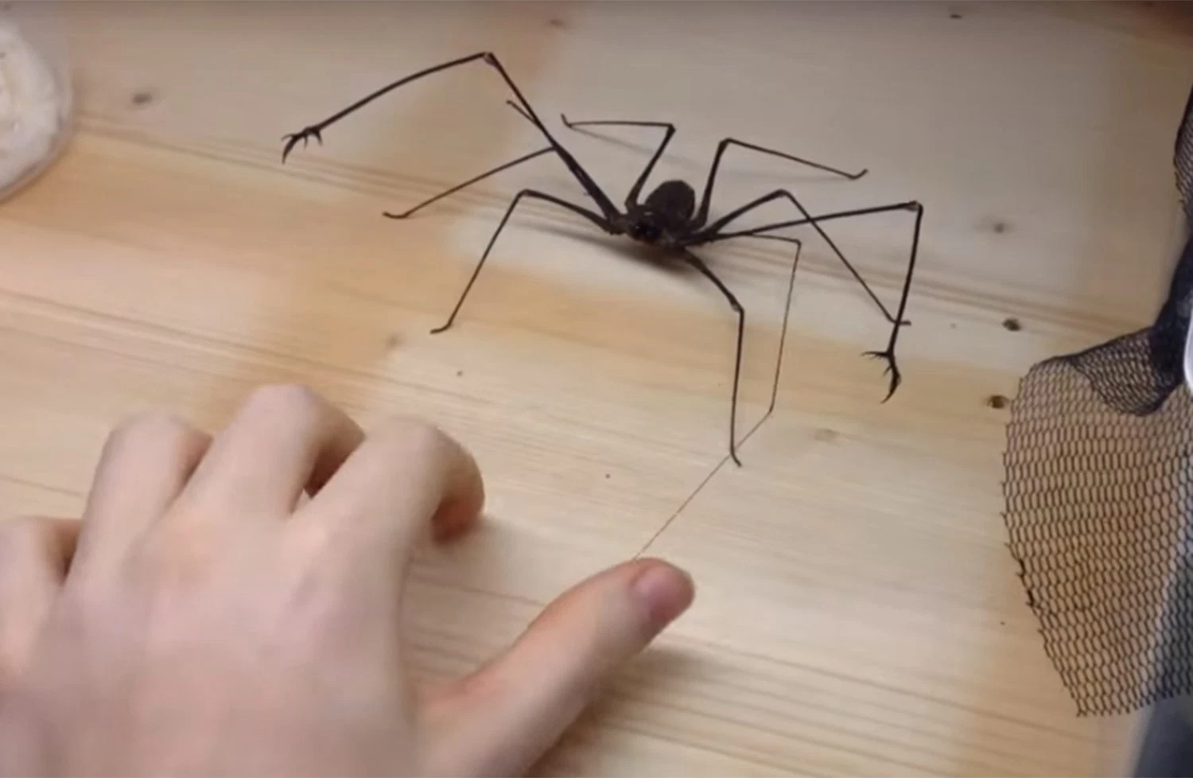
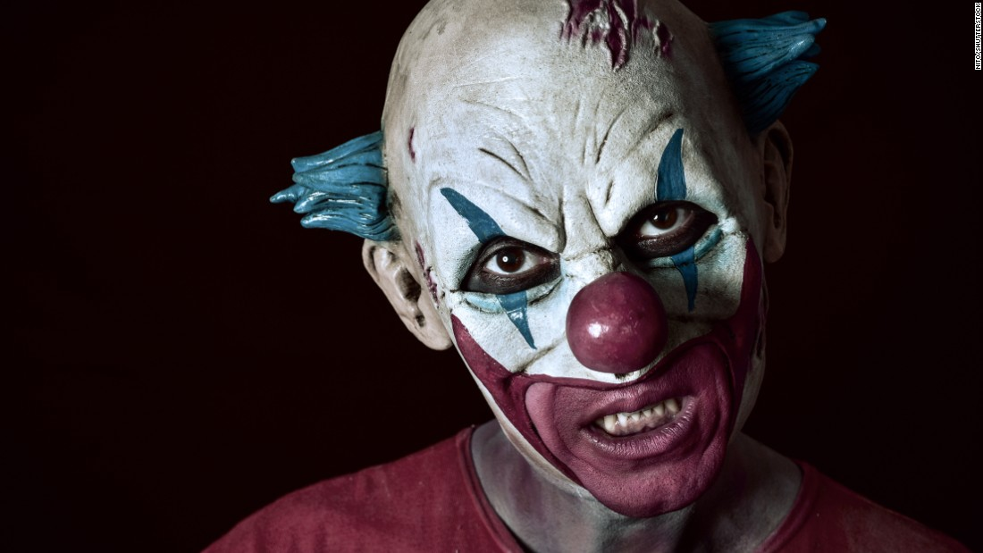
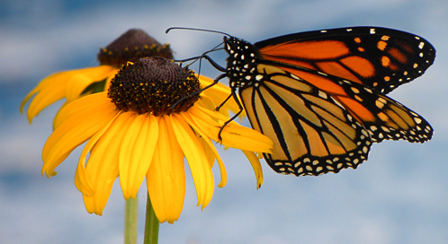
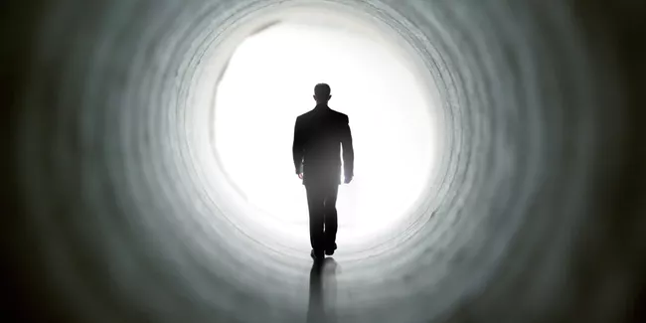


Slide 3
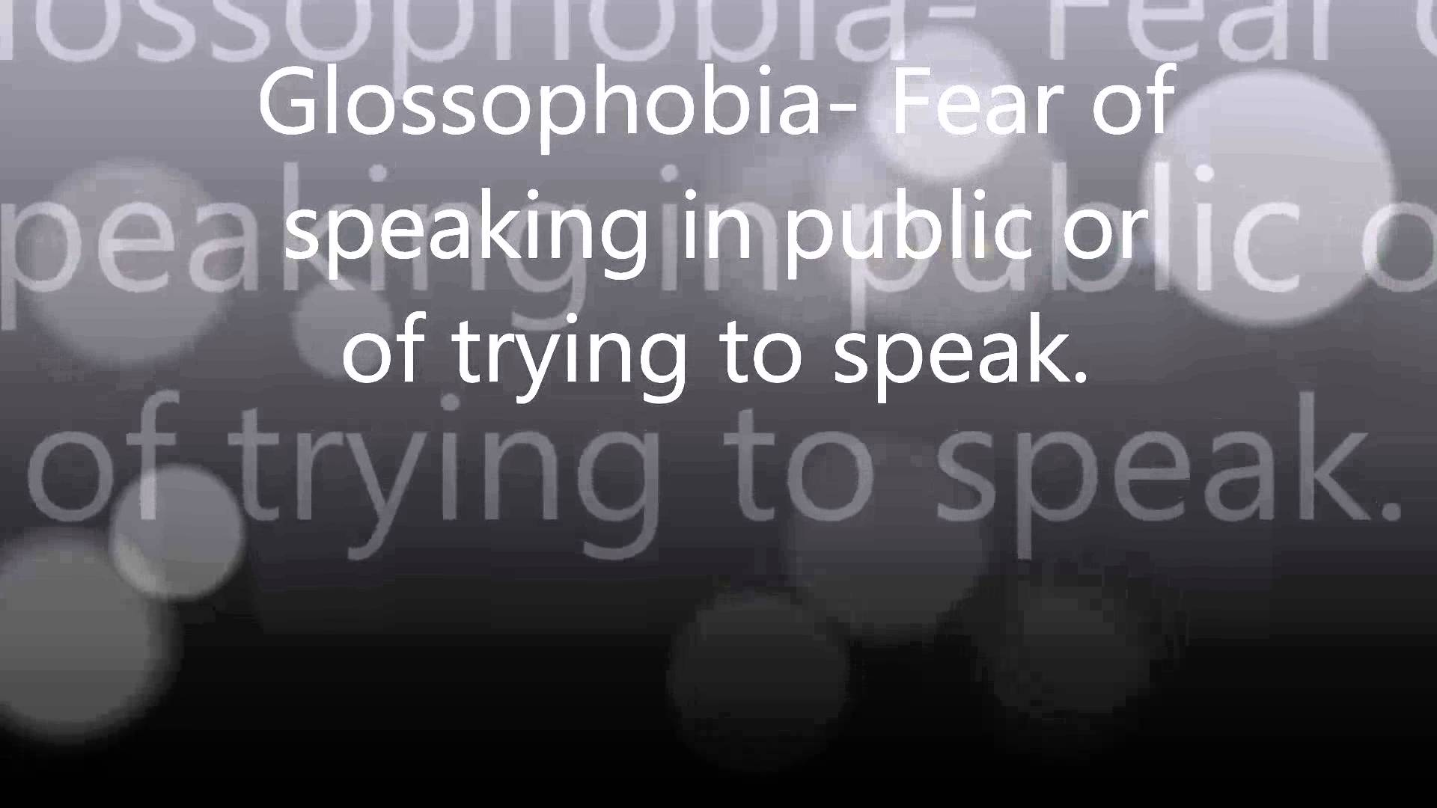

Slide 4
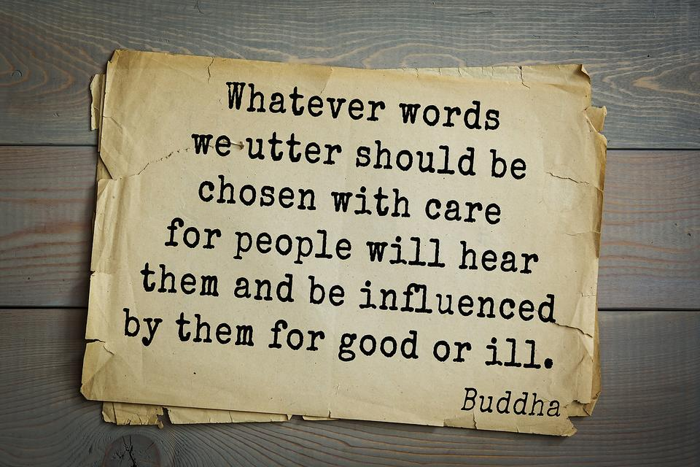
Notes:
Do Fear Handout

Slide 5

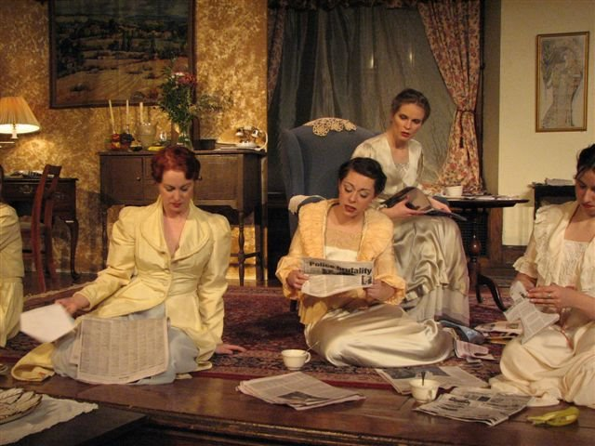




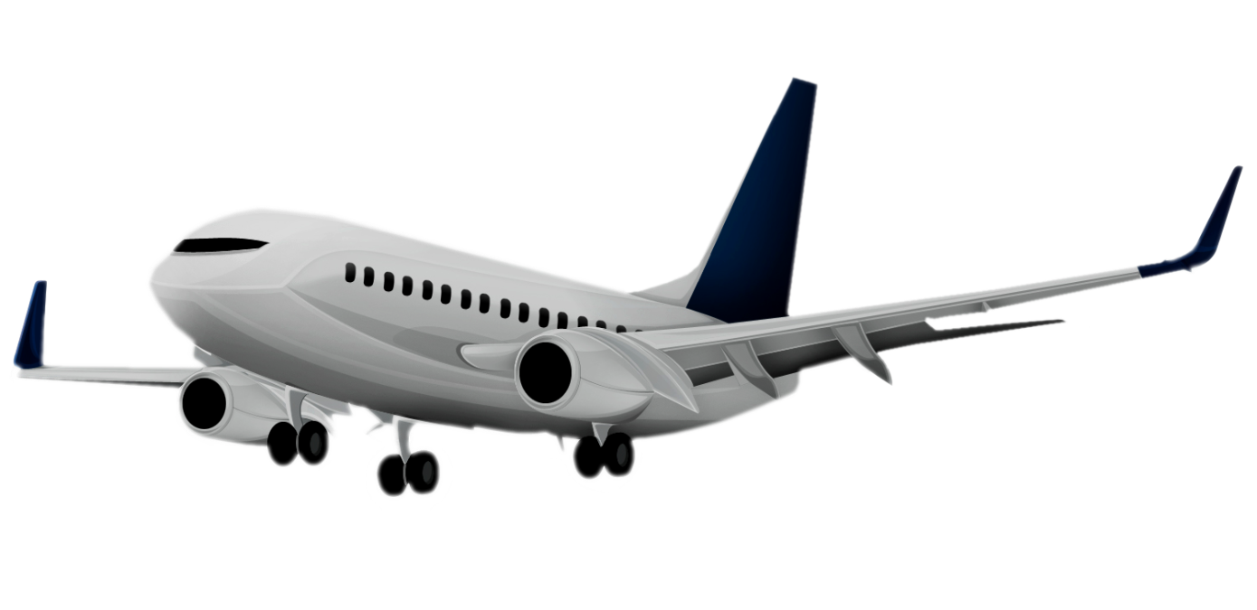
About Me

Slide 6

Audience-Centered
The Big Wind Blows for anyone who…

Slide 7
Introductions
Full name + childhood nicknames + What we should call you
Performing experience (school plays, choir, dance, etc.)
Something that scares you
Most people don’t know this about you…

Slide 8
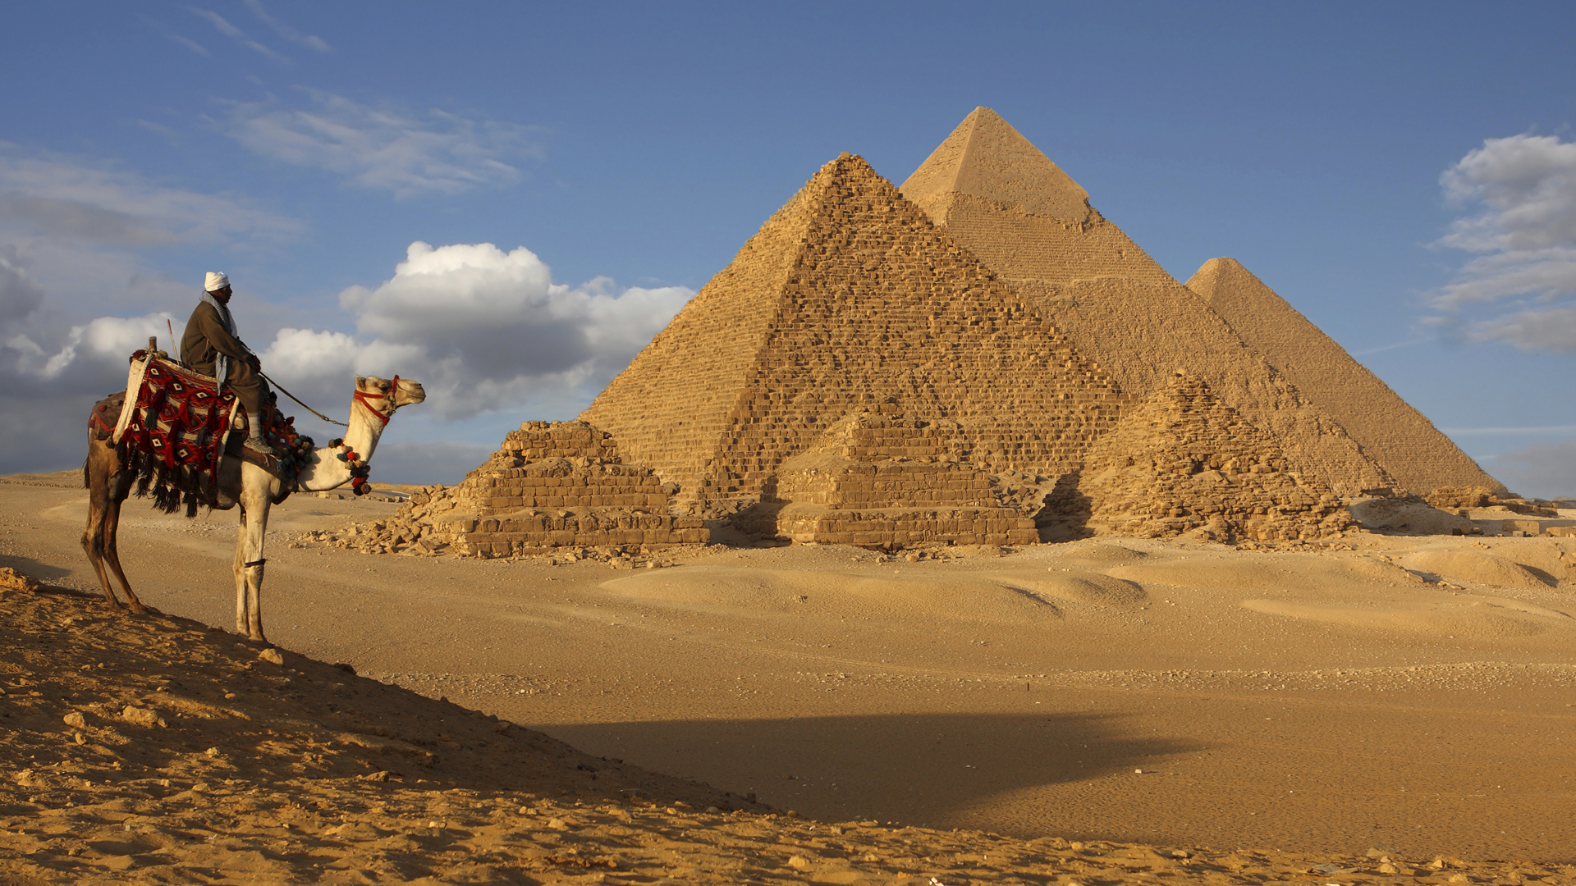
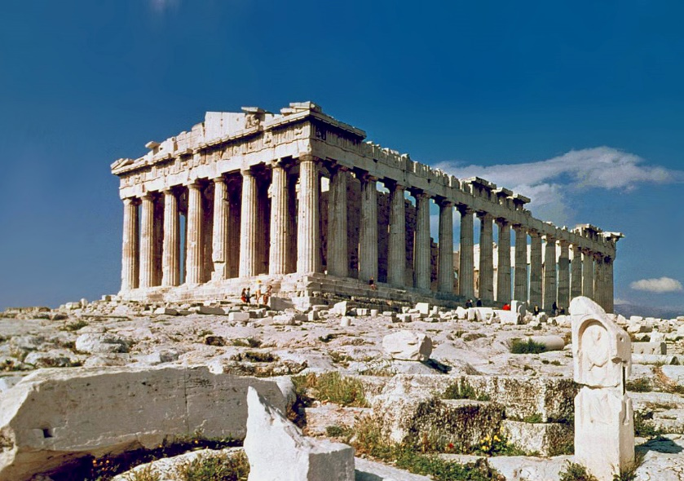
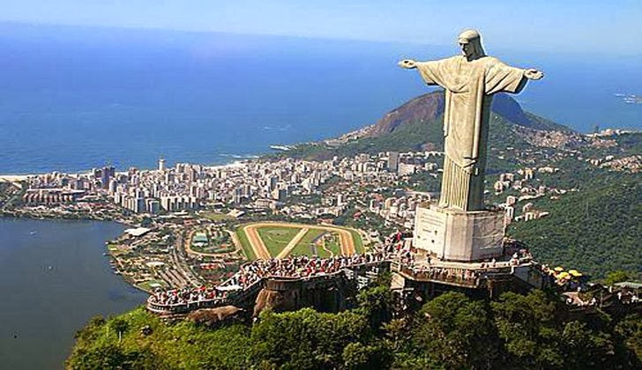

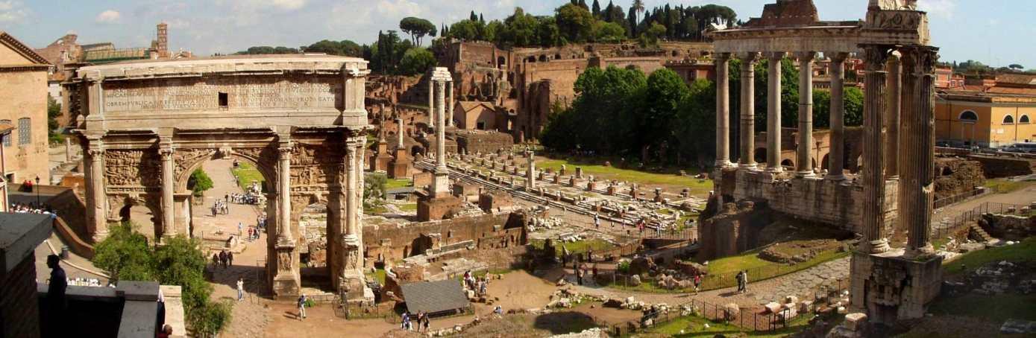
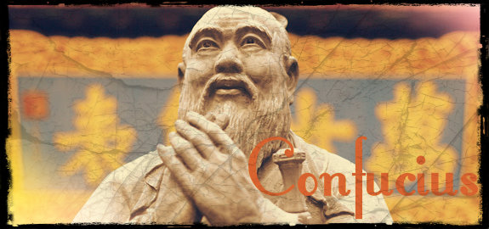

Slide 9
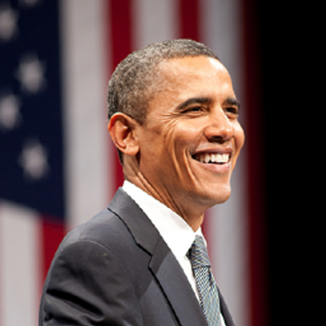

Slide 10
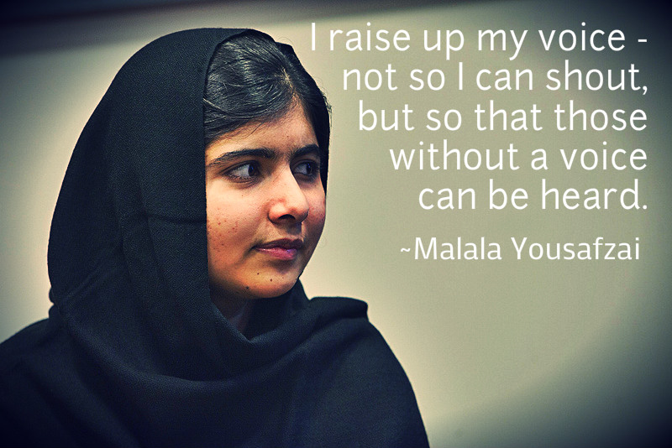
Notes:
You can make a difference. No matter which school, major career, this class will support you.

Slide 11

The Speech Communication Process
The Context: Environment or situation of the speech
Notes:
The time, place and circumstances of the communication.

Slide 12

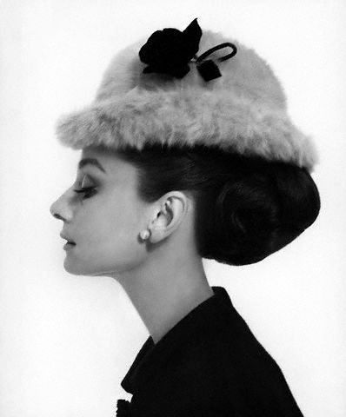
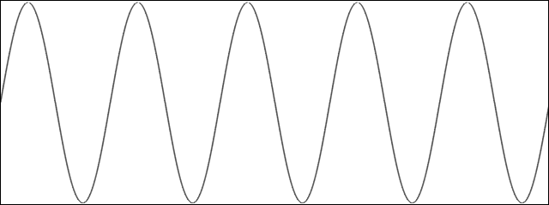
The Speech Communication Process
The Message: Communication from the Source
Speaker must encode, receiver must decode
Notes:
Give example of non-verbal message conflicting with verbal message, splitting the message in two.

Slide 13
The Speech Communication Process
The Channel: Modes of Communication
Visual and auditory

Slide 14
The Speech Communication Process
Feedback: Communication from the Receiver
Speaker must encode, receiver must decode

Slide 15



The Speech Communication Process
Noise: Anything that blocks the message
Physical, Psychological, Physiological
Notes:
Can they come up with an example of external, of internal?

Slide 16
The Speech Communication Model
Physical Noise
The Situation
Psychological Noise
Message
Visual & Auditory Channels
Feedback
The Speaker
Physiological Noise
The Listener

Slide 17


Slide 19

Grade Breakdown:
Speech Presentations 50%
Peer Feedback Assignments 10%
Writing Assignments 20%
Exams 20%
Late Work Policy:
Speech Presentations: YouTube!
Peer Feedback Assignments – Can’t make up ☹
Writing Assignments: -10% up to one week late
Exams 20% - in office before next class session

Slide 20
Notes:
Do Fear Handout

