Slide 1
Fundamentals of Speech
With Professor Collier
Demonstration

Slide 2
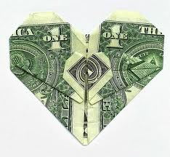
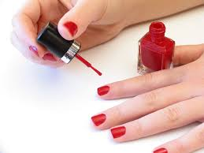
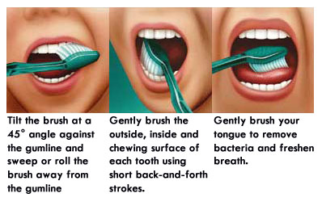
Speech Ideas

Slide 3
Demonstration Speech
Participation
Plan B
Patter

Slide 6
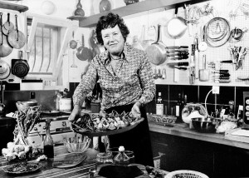

Slide 7
Steps
How You Learned + Why We Care
Steps in order
Now you know how to…
This will benefit you….

Slide 8
