Slide 1
Fundamentals of Speech
With Professor Collier
Introduction Speeches + the Art of Demonstration

Slide 3
Informative Speaking

Slide 4
Informative Speaking: Difficult Topics

Slide 5
Choosing a Topic: Explain (How or Why)

Slide 6
Choosing a Topic: Definition (What)

Slide 7
Choosing a Topic: Descriptive (Visualize)

Slide 8
Outline
Topic
Introduction
Transitions
Main Points
Supporting Materials
Conclusion
References

Slide 9
Importance to the Audience
Spiders
Bubble Gum
Toronto, Canada
Social Security
High Heeled Shoes
Mustaches
Alligators
NYPD

Slide 10
Notes:
Story – tell one. Why? Human element.

Slide 11
Introduction: Attention
Notes:
1 in four people develops some form of mental illness at some stage in life.
1.) Bigger than Most Countries Currently, more than 40 million Americans hold student debt. The population with student loans is actually greater than the entire population of Canada, Poland, North Korea, Australia and more than 200 other countries. It's also about four times greater than the population of Sweden.

Slide 12
Introduction: Attention
Notes:
3rd Biggest Co2 Emitter – 1/3 is wasted!

Slide 13
Introduction: Attention
Notes:
Ask some – silent survey – why not pass around?

Slide 14
Introduction: Attention
Notes:
Tell me some quotes.
We know speaker – Celebrities, Political Leaders,
Don’t reinvent the wheel – they said it best.

Slide 15
Introduction: Attention
Notes:
Story – tell one. Why? Human element.

Slide 16
Introduction: Reveal
Notes:
Collective experience.

Slide 17
Introduction: Benefits
Notes:
Relate weird topics to class.
We are all human, BMCC, NYC, food shelter clothing, love, acceptance, learning.

Slide 18
Introduction: Credibility
Notes:
Collective experience.

Slide 19
Introduction: Credibility
Notes:
NY Times

Slide 20
Introduction: Preview
Notes:
Tell ‘em what you’re gonna tell them so we can follow along.

Slide 21
Transition Phrases
Let’s begin, Let’s move on to…
I’d like to start with, Now we’ll look at….
First, Second, Third…
Next, Finally
In conclusion, I’d like to end with, I’ll finish up by saying…

Slide 22
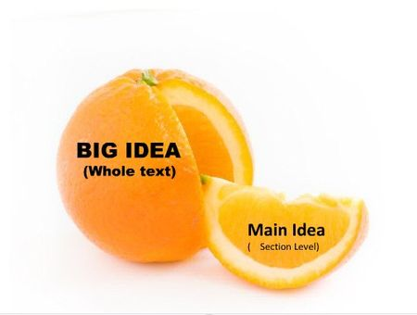
Main Ideas
Must be complete sentences
Notes:
2-5, subdivides topic

Slide 23
Supporting Material
Bullet Points
Each main point should have 2-3 supporting materials – combination of examples, statistics, testimonies.
Notes:
P13-14

Slide 24
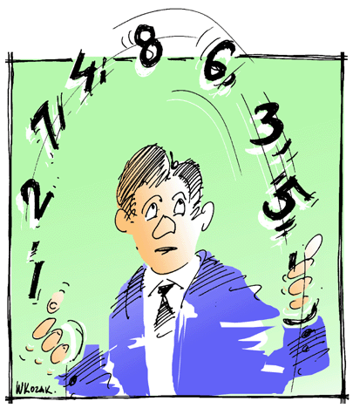
Explain
Round
Un-Biased
Cite!

Slide 25
Examples
Brief
Extended-(Story)
Hypothetical

Slide 26
Testimony
Expert
Peer

Slide 27
Notes:
Subway stats – think of the 3 women closest to you – one sexually assaulted.
Shock people – bacteria living in your eyeball?

Slide 28
Conclusion: Signal
Notes:
To wrap up, etc.

Slide 29
Conclusion: Summarize
Notes:
Tell ‘em what you told ‘em

Slide 30
Conclusion: Strong Statement
Notes:
Hit it.

Slide 31
Three References
Minimum of 3
One MUST be a NEWS source
Any Citation Style
APA MLA Chicago AP
Collier, R. (2017). World’s best professor. New York Times. Retrieved from http://www.nytimes.com/wbprofarticle

