Slide 1
Fundamentals of Speech
With Professor Collier
Introduction Speeches + the Art of Demonstration

Slide 2
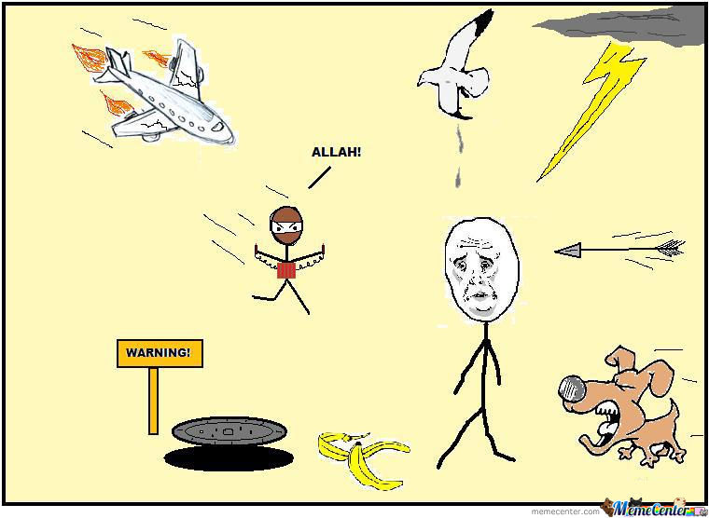


Slide 3
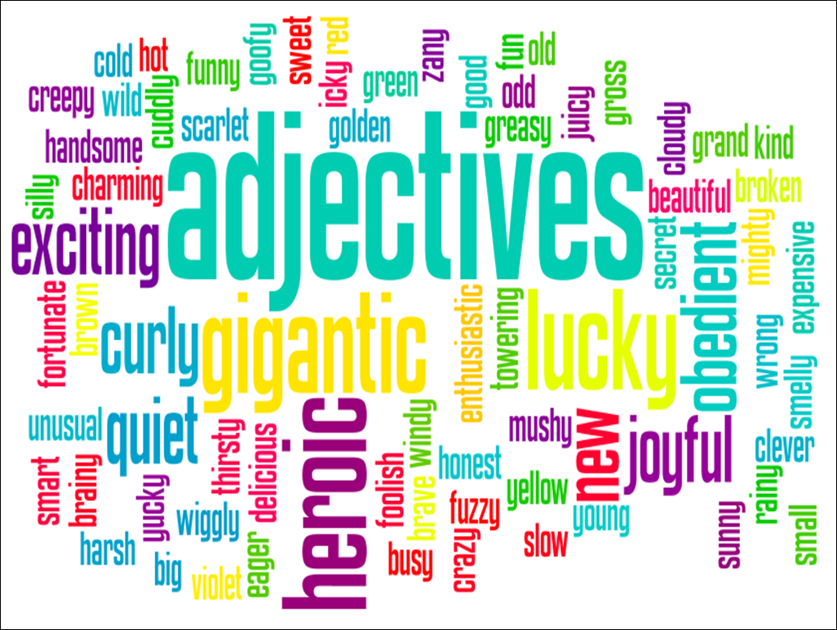
Know Your Audience

Slide 4


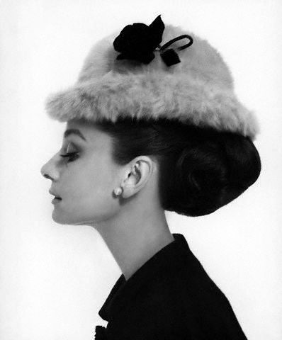

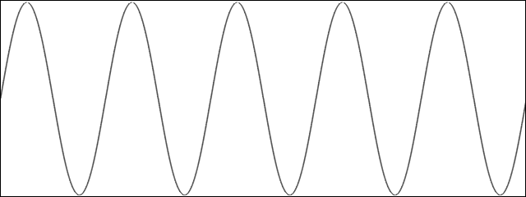

The Speech Communication Model
Physical Interference
The Situation
Psychological Interference
Message
Visual & Auditory Channels
Feedback
The Sender
Physiological Interference
The Receiver

Slide 5
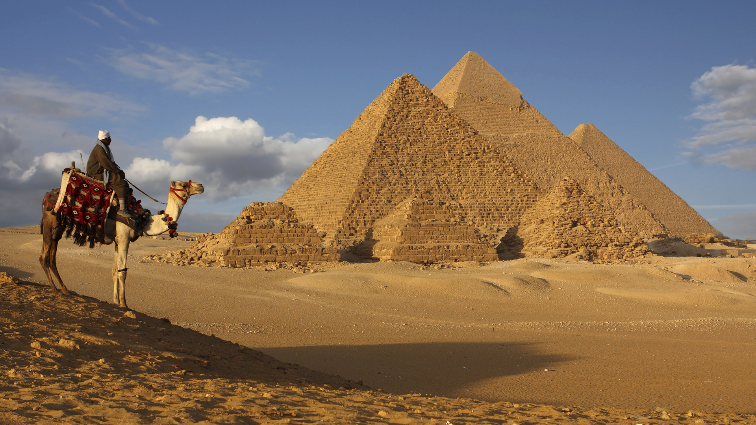




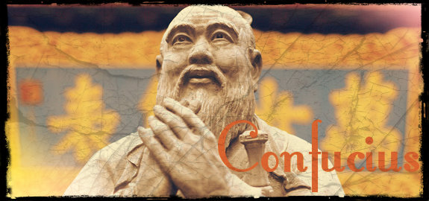

Slide 6

Tongue Twister
Unique New York, you need New York
You know you need unique New York

Slide 7
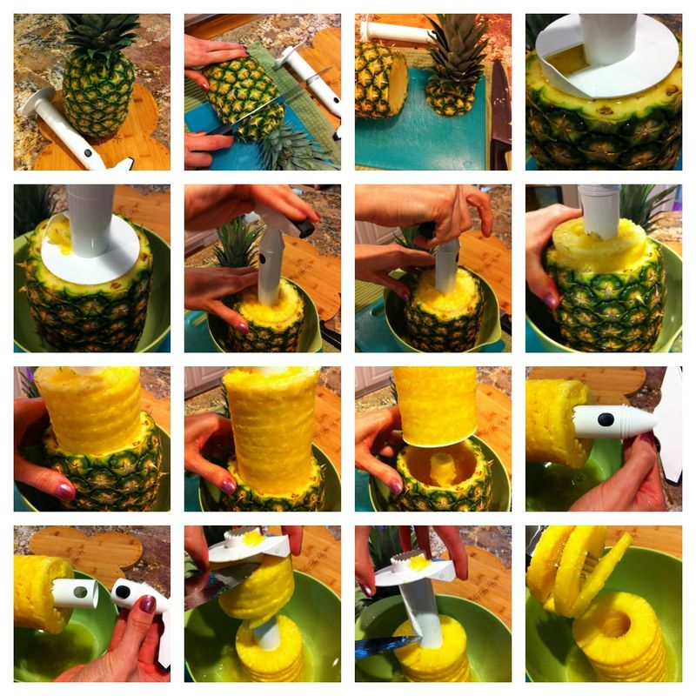
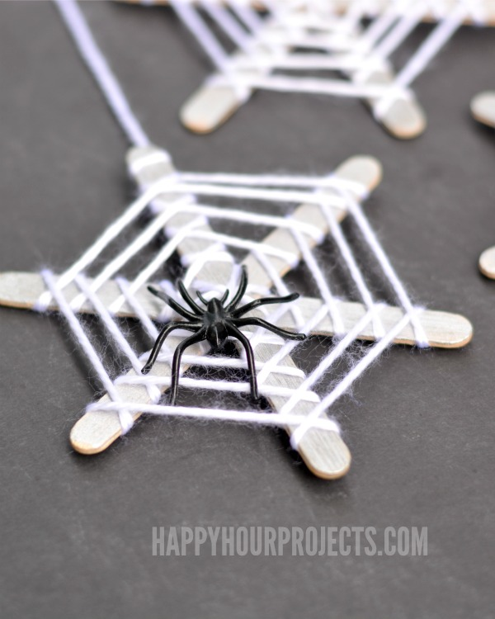


Slide 8

#1 – Something you are good at (bake brownies from scratch, French braid hair, make paper airplane)
#2 – Something you want to learn how to do (make a tutu, speak Russian, walk on my hands)
#3 – Something that is really easy to do (wash hands, brush teeth, tie shoes, chew gum)

Slide 9


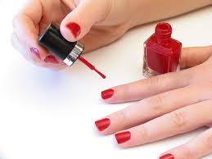
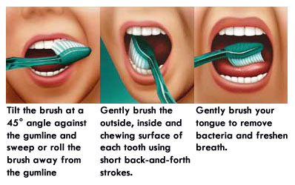

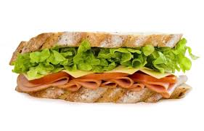
Speech Ideas

Slide 10
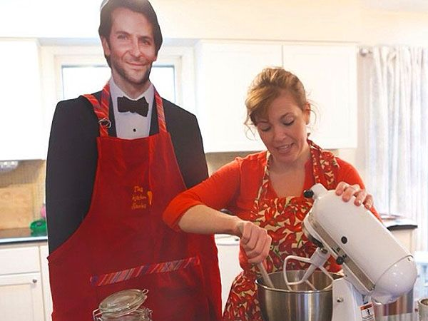
Props

Slide 11
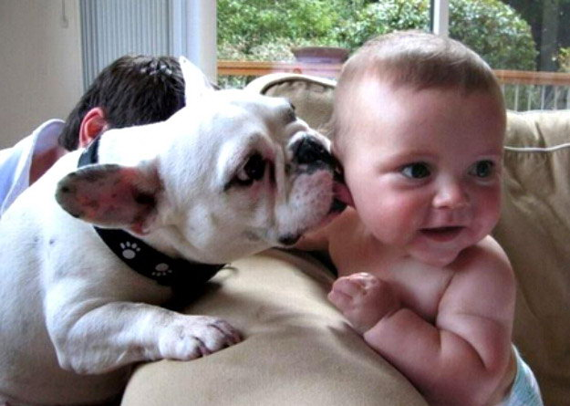
Children and Animals

Slide 12
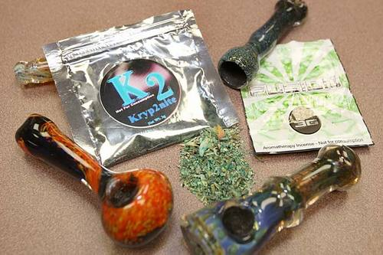

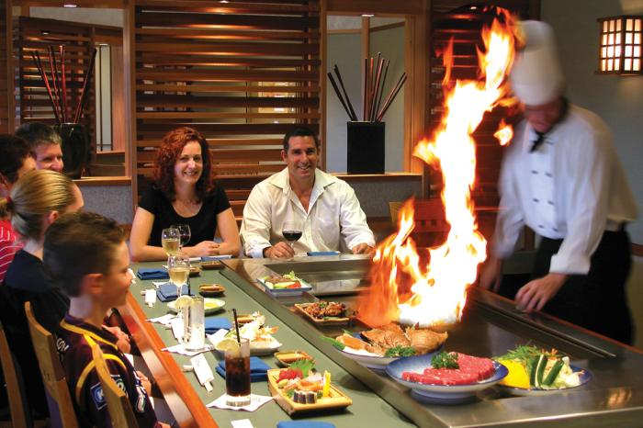
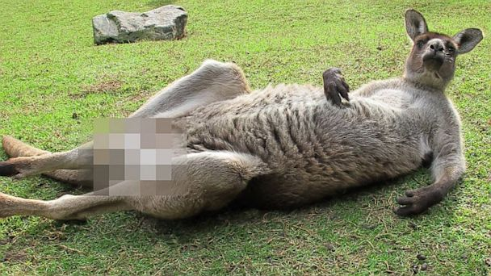
Contraband

Slide 13
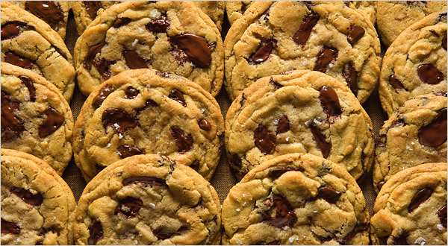

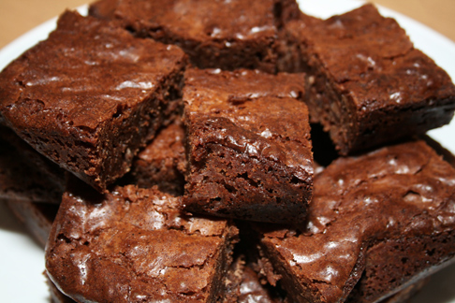

Slide 14

Homework: THREE Potential Topics

Slide 15
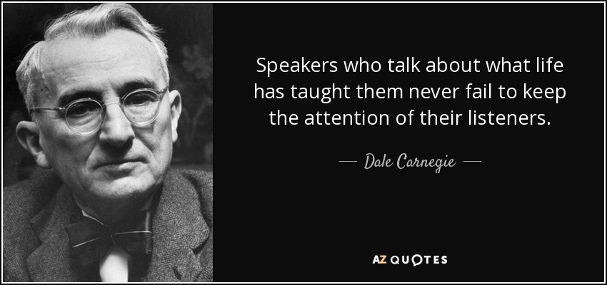
Notes:
Do Fear Handout

