Slide 1
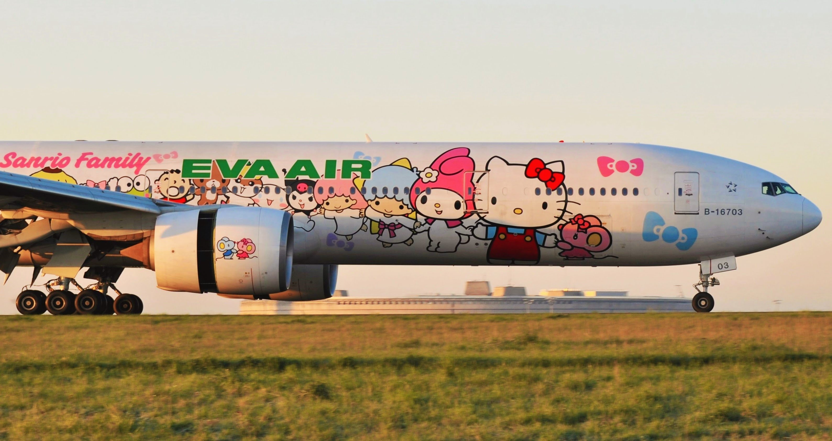
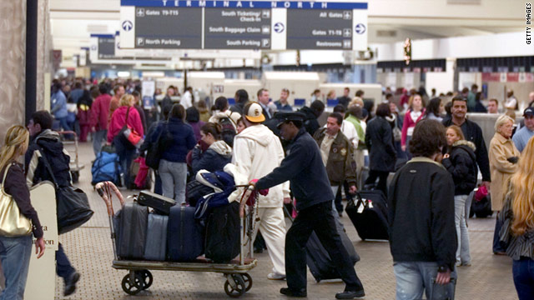
Notes:
A – Airline – Better – Cheer you Up?
B – Eva Airlines Hello Kitty
C – NYC Great Travel Opp – know more
D. Never flown, research
E. – How concept started, and what you would experience

Slide 2
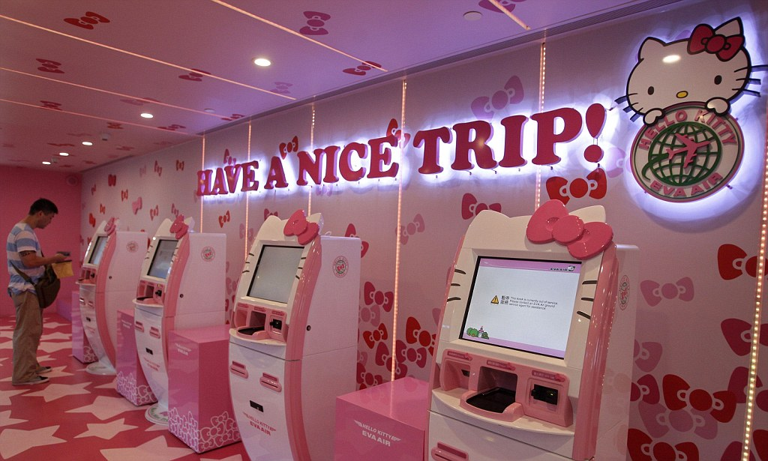
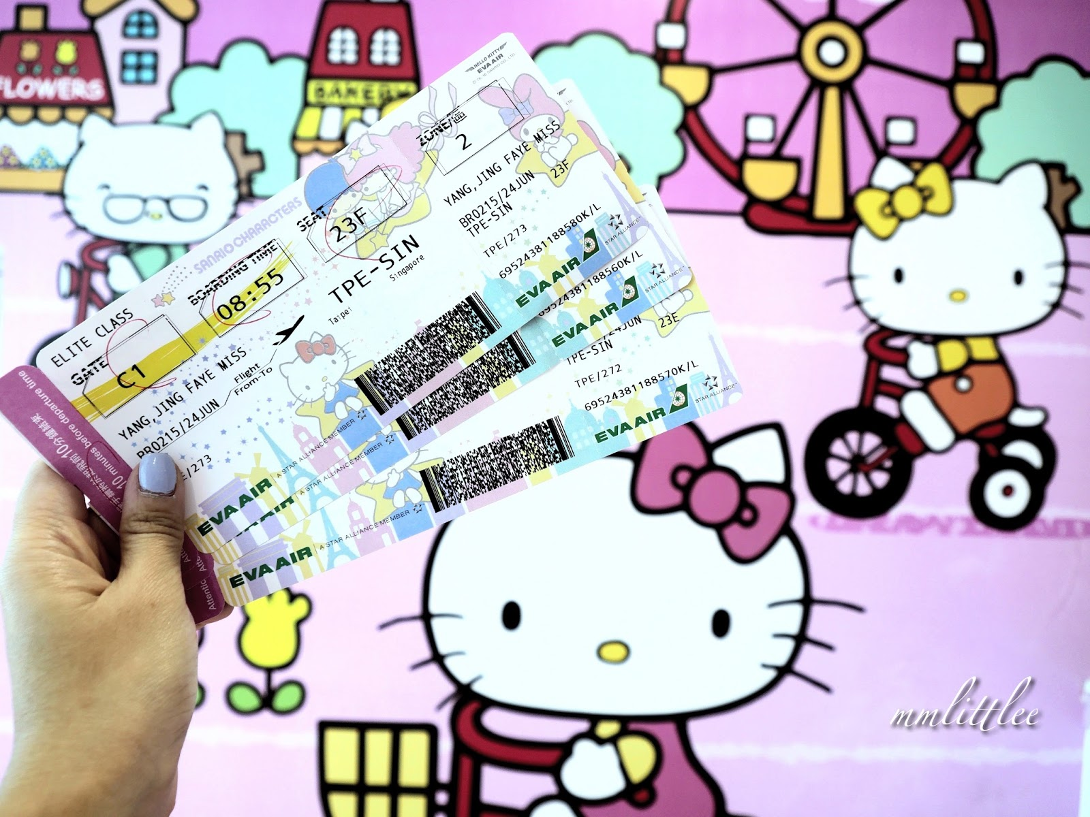
Notes:
(Smart Business Online, 2013) More than 10 years ago, Sanrio approached EVA Air about selling Hello Kitty-branded products inflight. EVA Chairman KW Chang, a visionary leader of the successful Taiwanese company, had a bigger idea.
What if EVA Air made Hello Kitty part of the flight experience and instead of merely offering products, the airline and Sanrio collaborated to create a fun-filled immersive Hello Kitty and Friends travel experience.
After only six months of collaboration between the two companies, EVA Air launched its first generation of the Hello Kitty Jets in October 2005.
How did these two companies successfully work together?

Slide 3
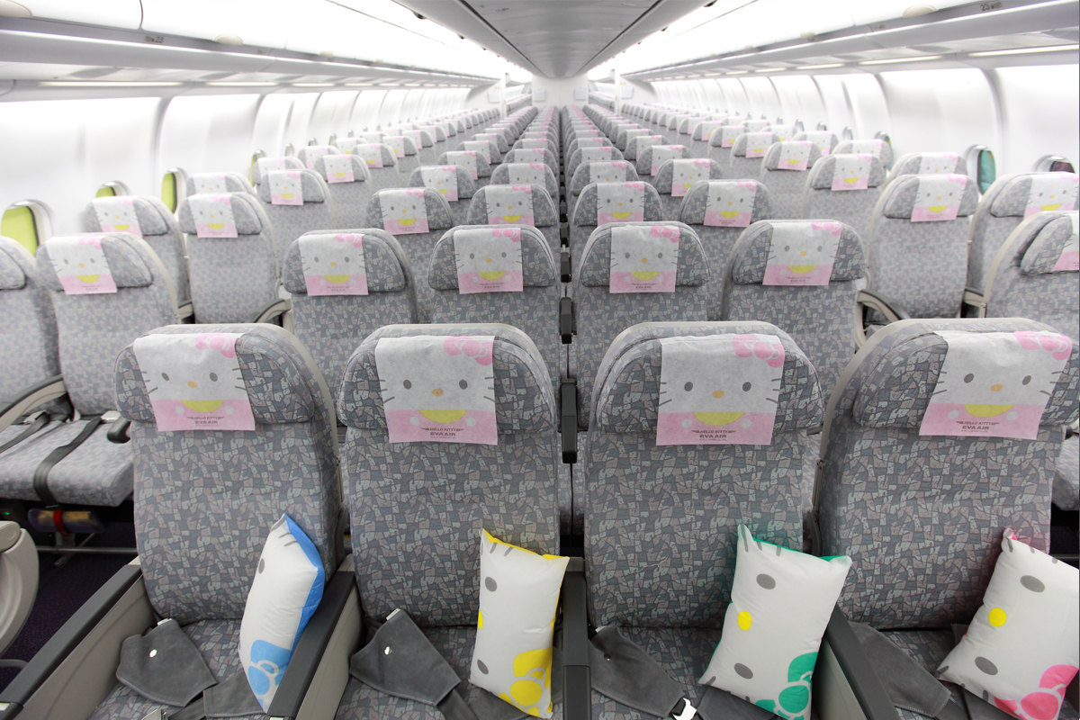
Notes:
“I initiated our Hello Kitty Jet concept (above) to make flying fun. Travelers’ responses in Asia, Europe and the United States tell us we are succeeding,” said EVA Air Chairman KW Chang. World Airlines News, 2013

Slide 4
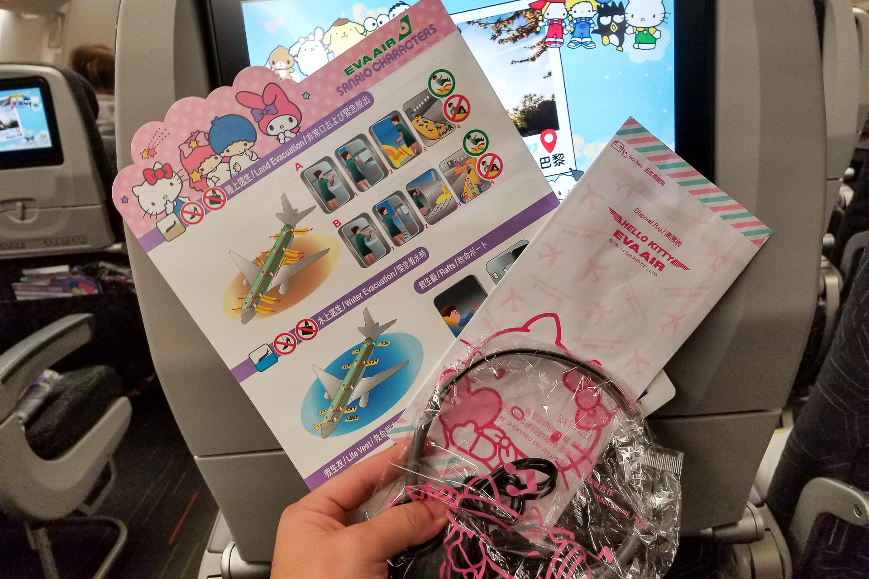
Notes:
Marie Claire – July 19, 2018 –LAURA STUDARUS “It was startling that there were no children on the flight. Or even any other overly-nostalgic millennials, making me and my travel buddy Josh the youngest in the cabin by at least 10 years.”

Slide 5
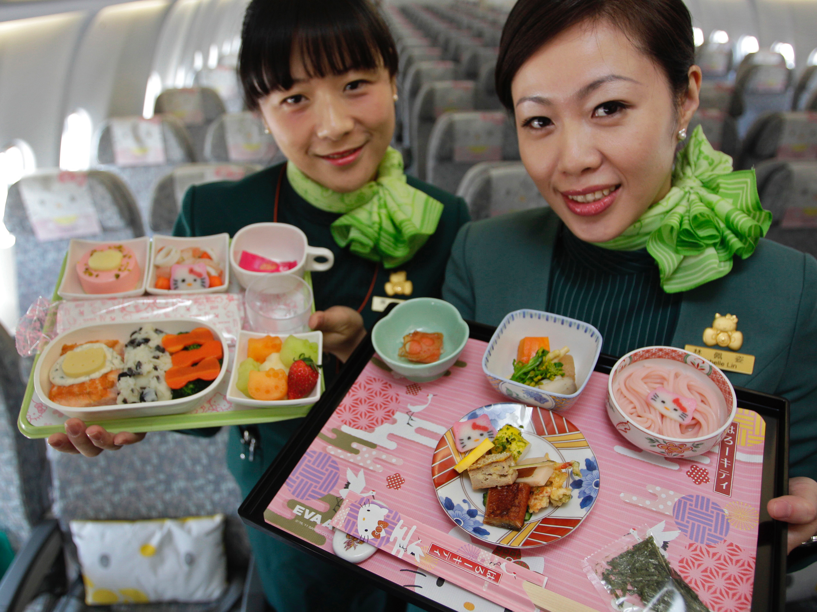
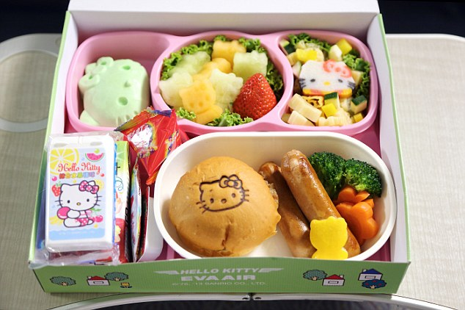
Notes:
EVA’s Hello Kitty Jets have become more successful than Sanrio projected. This concept appeals to a wide range of travelers as some passengers book flights to collect the service items (pillow cases, utensils, headrest covers and more). Besides the colorful décor and theme, every passenger receives warm, friendly service and comfortable aircraft.
SB, 2013
Passenger bookings on the Hello Kitty Jets are approximately 3 percent higher than their regular aircraft and inflight duty-free sales of exclusive Hello Kitty and Sanrio items has climbed to $3 million a year.
https://worldairlinenews.com/tag/hello-kitty/
http://www.sbnonline.com/article/hello-kitty-eva-air-co-brands-with-well-know-pop-icon-with-houston-taipei-non-stops/
https://www.marieclaire.com/travel/a22366644/hello-kitty-flight/

