Slide 1
Fundamentals of Speech
With Professor Collier
Supporting Your Ideas

Slide 3
Oral Citation
According to…
Source + date
Summarize info

Slide 4
Use Your Words

Slide 6
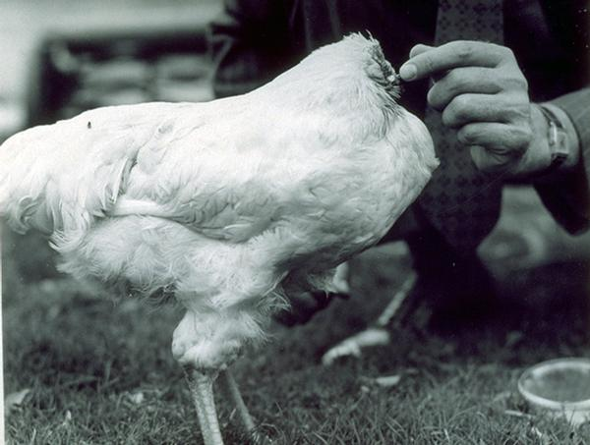

Slide 7
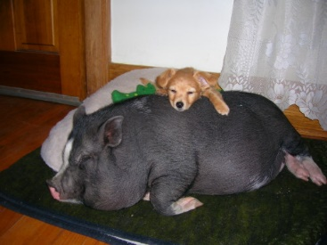

Slide 8
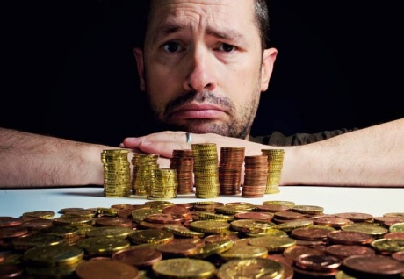

Slide 9
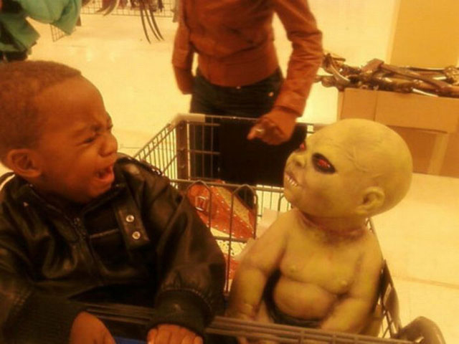

Slide 11
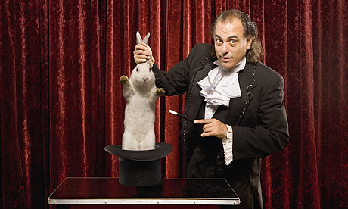

Slide 14
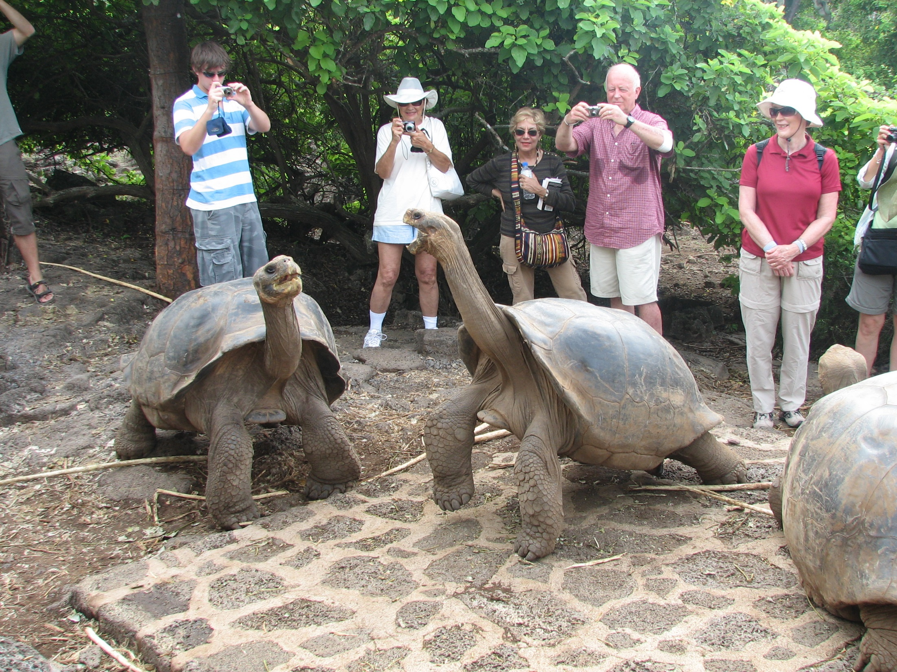

Slide 15
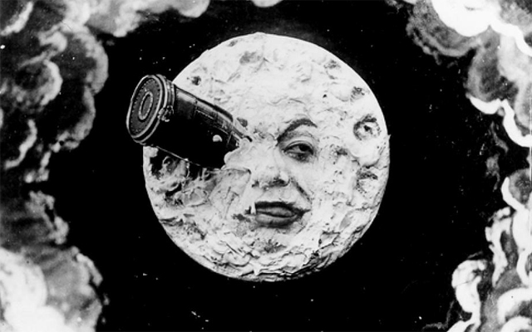

Slide 16
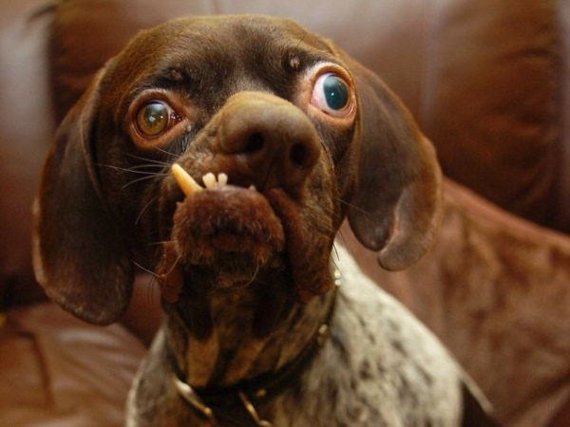

Slide 17
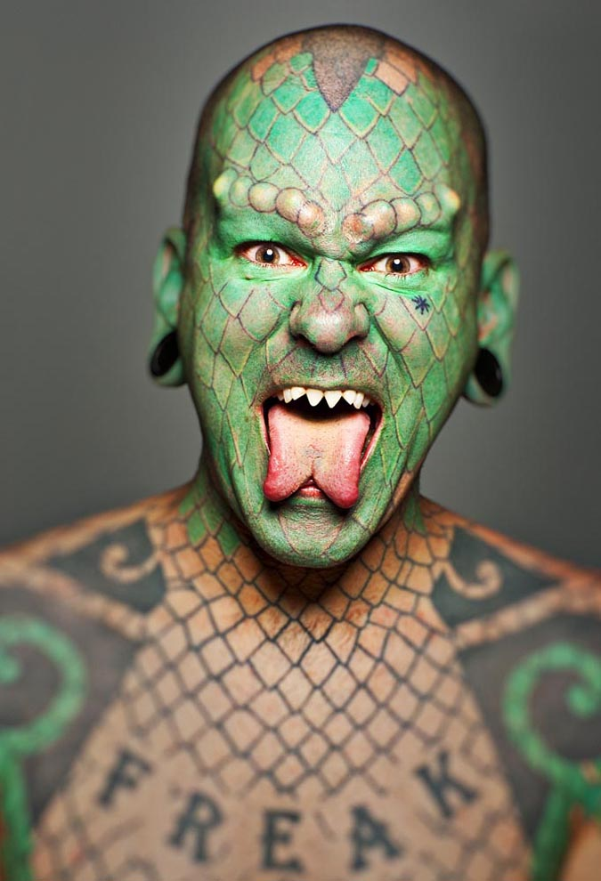
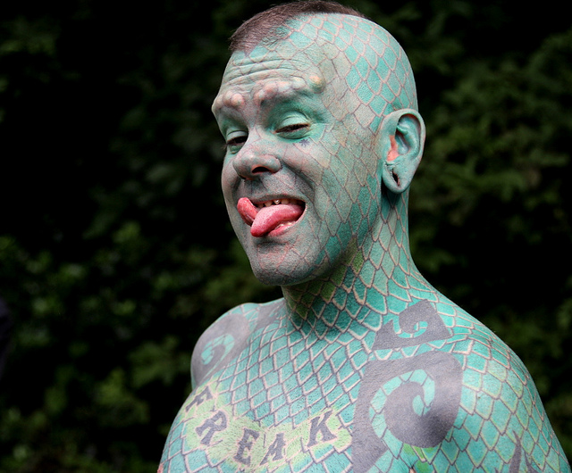

Slide 18
Eye Contact

Slide 19
Timing

Slide 20
Outline Check
Topic
Introduction
Transitions
Main Ideas
Support + Citation
Conclusion
References

Slide 21
Visual Aids
4-6 Slides
Images ONLY
2 Ways to Access

