Slide 1
Welcome to:
Fundamentals of Speech
SPE 100
With Professor Collier
(“Call yer” Mom)

Slide 2
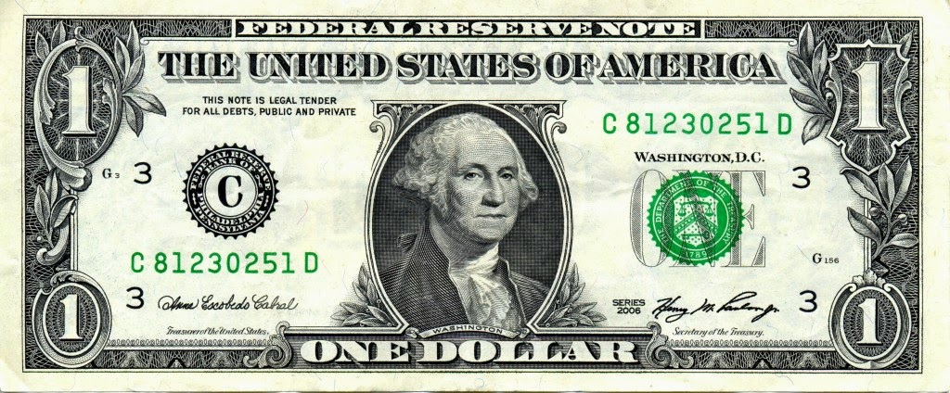

Slide 3
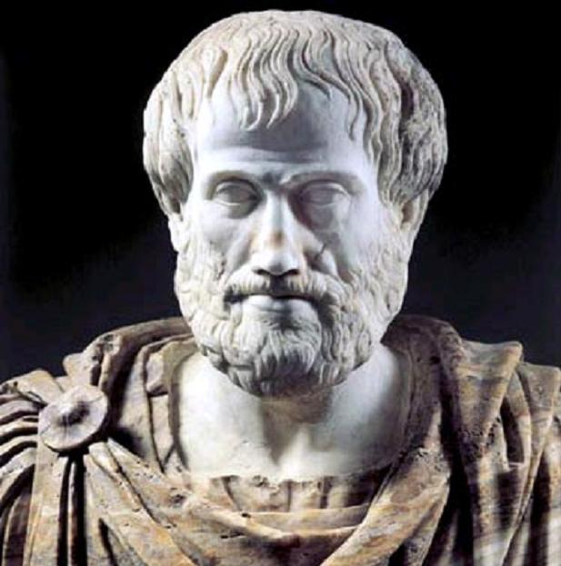

Slide 4
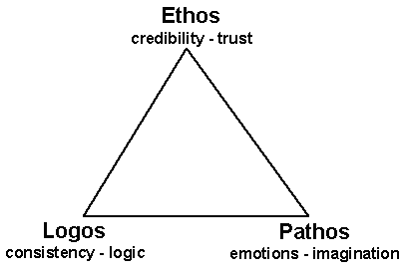

Slide 5
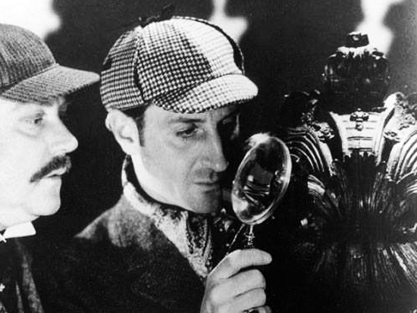

Slide 6
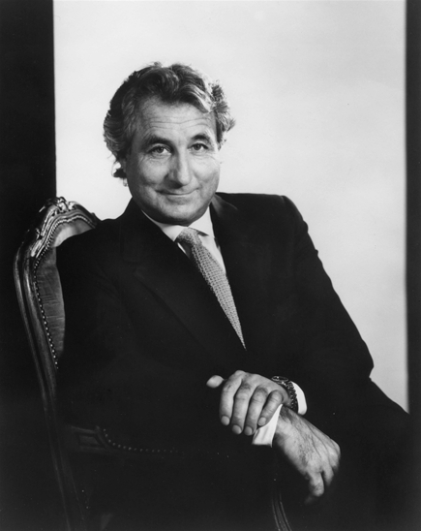
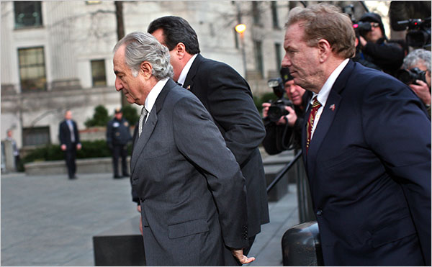

Slide 7
New York Post, 2010

Slide 8
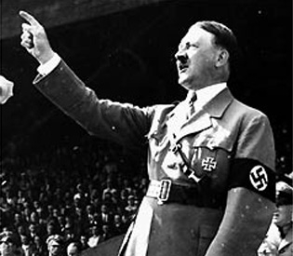

Slide 9
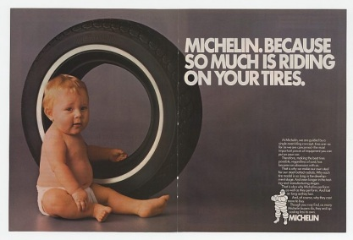

Slide 10
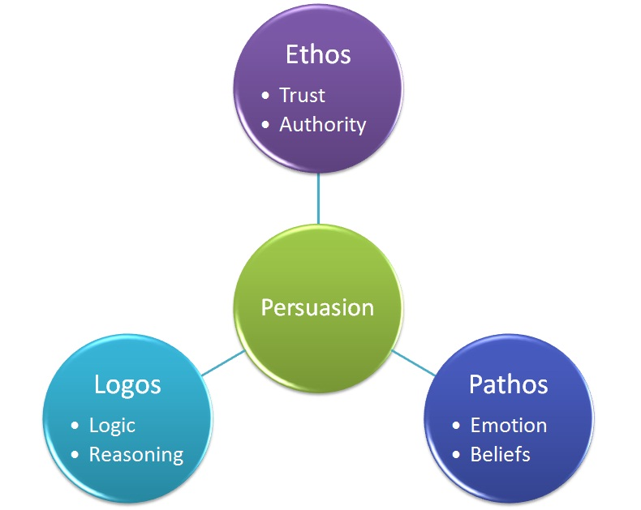

Slide 11
Your Name
Should/Shouldn’t
Believe/Disbelieve
Best/Worst
Do/Stop Doing

Slide 12
Fact – Value - Policy

Slide 13
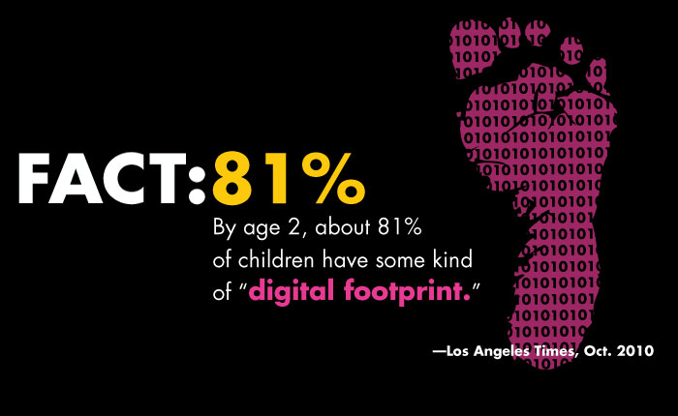

Slide 14
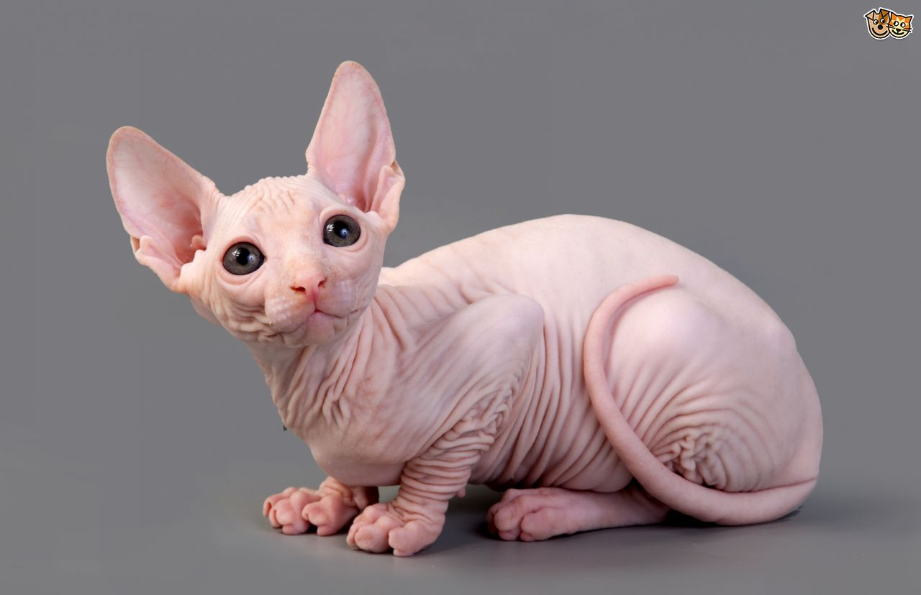
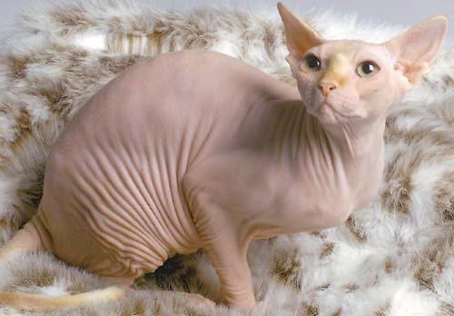
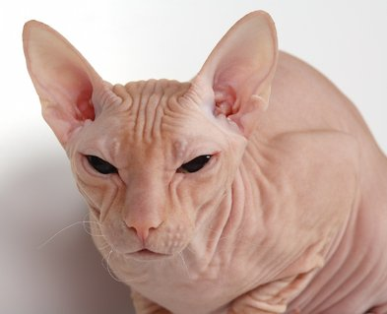

Slide 15
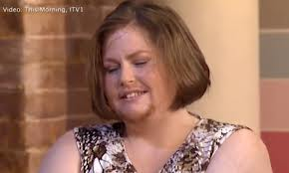
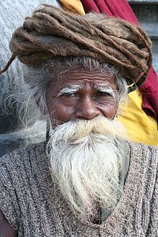
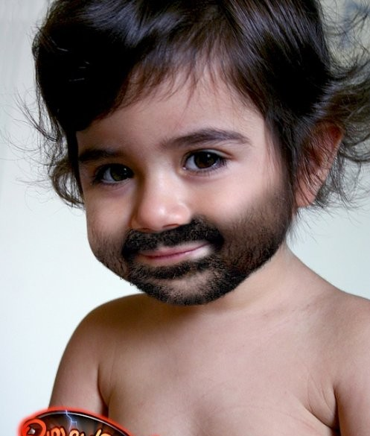

Slide 17
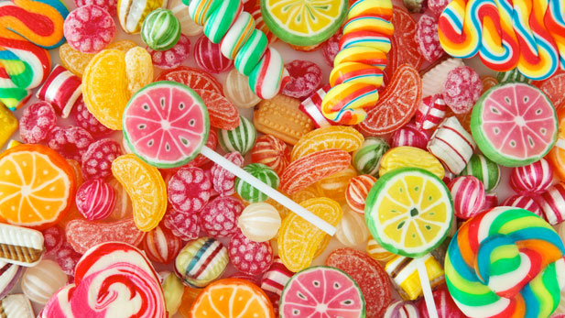
Eating sugar is really bad for you.

Slide 18
Rabbits and dogs share a common biological ancestor.

Slide 19
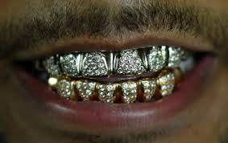
Grills are ugly and annoying.

Slide 20
“Fashion faux pas” should be against the law.

Slide 21
The increase of gang activity in New York is causing rents to go down.

Slide 22
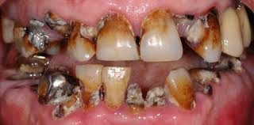
Brush your teeth at least twice a day!

Slide 23
Public Speaking is one of the best classes you can take at FIT.

Slide 24
Everyone should visit Morocco at least once.

Slide 25
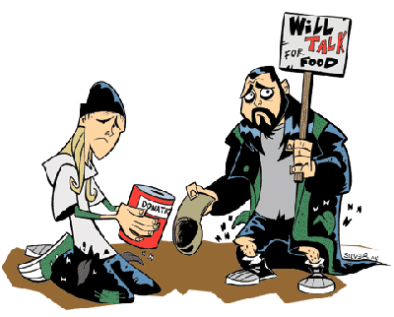
Earning a college degree does not guarantee a high-paying job.

