Slide 1
Public Speaking
With Professor Collier
Audience Analysis

Slide 2
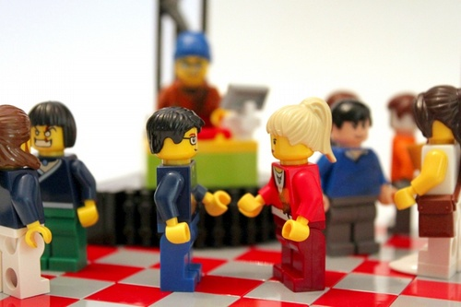
Identification

Slide 3
Race & Ethnicity

Slide 4
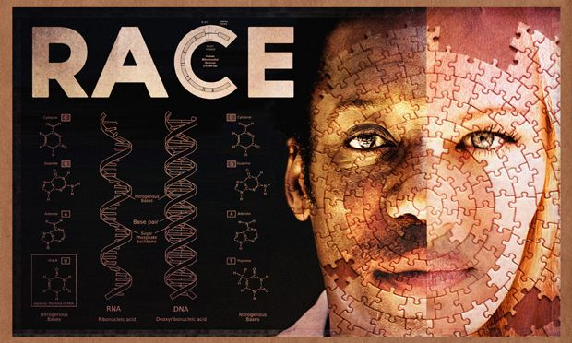
Notes:
https://grants.nih.gov/grants/guide/notice-files/NOT-OD-15-089.html

Slide 5
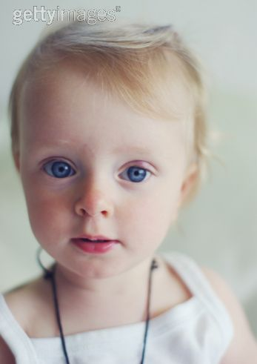
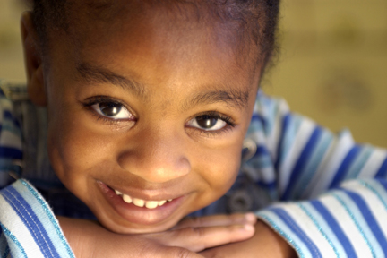
Caucasion: Skull: High forehead,Little supraobital development. Nose:Long,narrow,high in both root and bridge.
Caucasian races (Aryans, Hamites, Semites)
Mongoloid: Skull: High incidence of Brachycephaly(Short Round Head). Wide and short, projecting cheek bones, Prognathism rare. Shovel shaped incisors common especially in Asia. Nose: Mesorine(Low and Broad in both root and bridge.
Mongolian races (northern Mongolian, Chinese and Indo-Chinese, Japanese and Korean, Tibetan, Malayan, Polynesian, Maori, Micronesian, Eskimo, American Indian),
Negroid: Skull: Forehead most often high, little supraobital development. Nose: Low & broad in root and bridge with characteristic depression at root.
Negroid races (African, Hottentots, Melanesians/Papua, “Negrito”, Australian Aborigine, Dravidians, Sinhalese)

Slide 6
Black, White, Asian, Hispanic

Slide 7
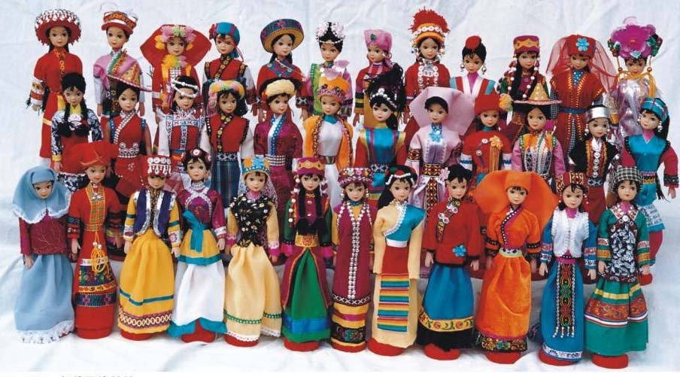

Slide 8
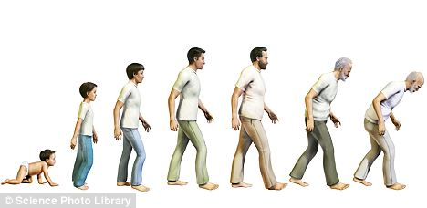

Slide 11
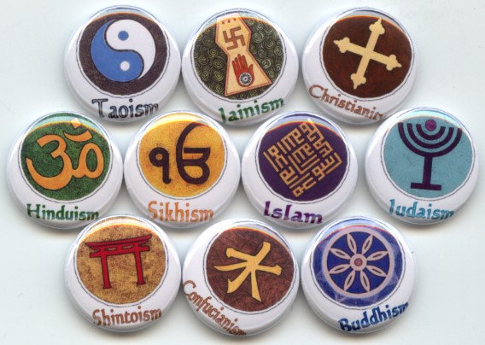

Slide 12
Notes:
Poll everywhere.

Slide 13
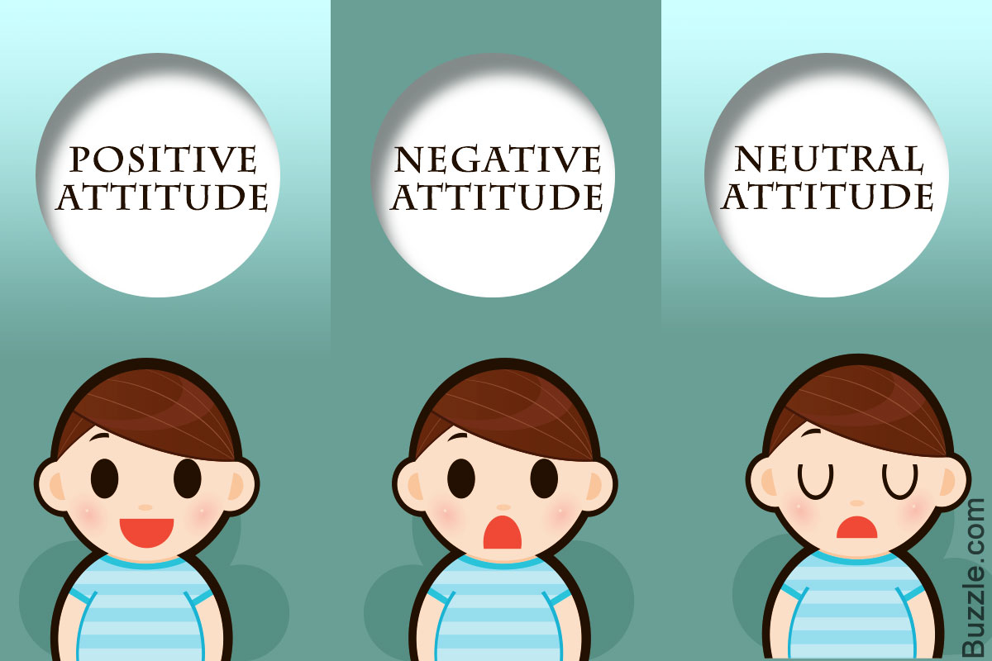
Guide
Expectations
Learned Dispositions

Slide 14
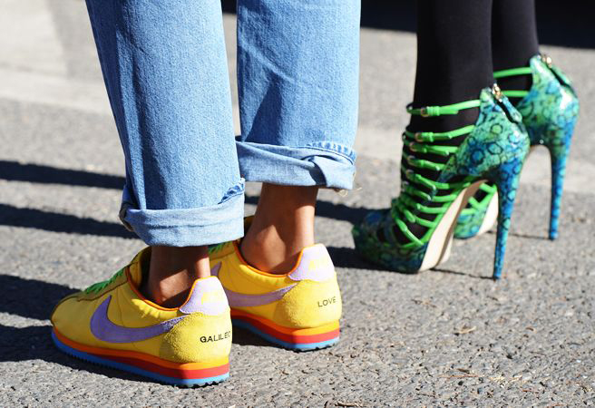
Cognitive Dissonance

