Slide 1
Fundamentals of Speech
With Professor Collier
Speech Delivery

Slide 2
Fact, Policy, Value
Atheism can’t be proved.
Rats are a wonderful part of New York City!
My Momma is better than your Momma.
Join New York Jedi today, and witness the power of the force in your life.
New York City will one day be entirely under water.
You should get a Citibike membership now, before they raise the prices!

Slide 3
Logos, Ethos, Pathos
I tell a story so touching that it makes most of the gals and all of the guys in our class cry.
I’m friends with most of the people in our class.
I use oral citation to let the audience know where my information comes from.
I outline several reasons why the audience should support my topic.

Slide 4
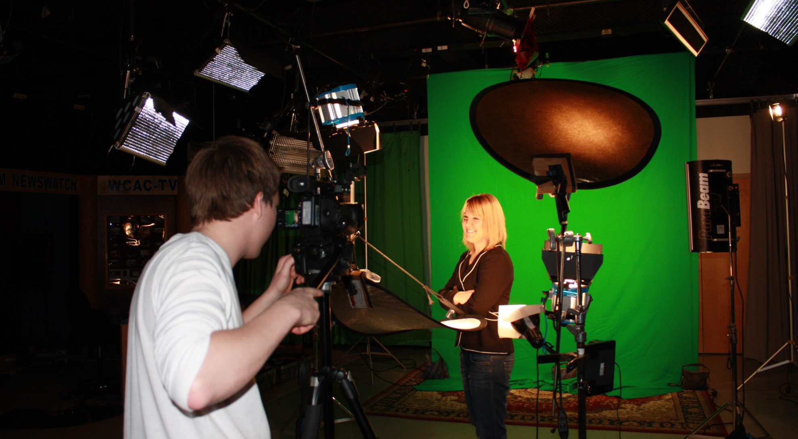
Memorized

Slide 5
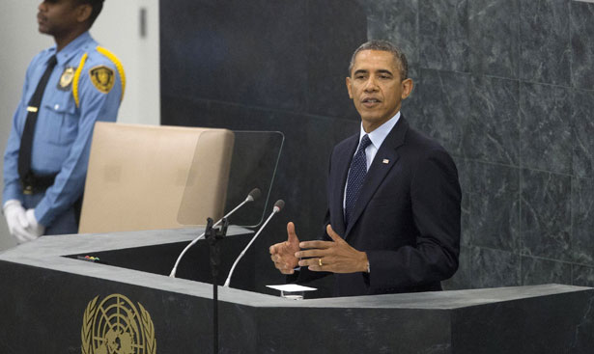
Manuscript

Slide 6
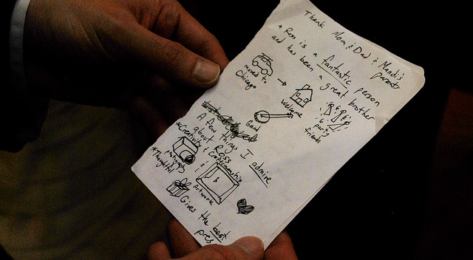
Extemporaneous

Slide 7
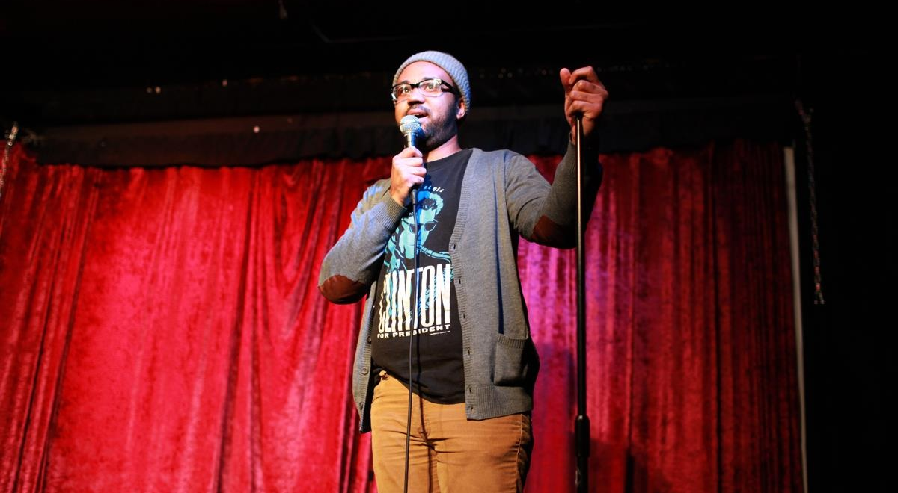
Impromptu

Slide 8
Voice
Projection
Rate
Pitch, Inflection, & Timbre
Pauses (Vocalized)
Pronunciation v. Articulation

Slide 9
Body
Appearance
Movement
Gestures
Parade Rest
Broken Wing
“Arm Clutch”
Fig Leaf Clutch
EYE CONTACT
head bobber, balcony gazer, obsessor
80-90%

