Slide 1
Public Speaking
With Professor Collier
Chapter 12

Slide 2
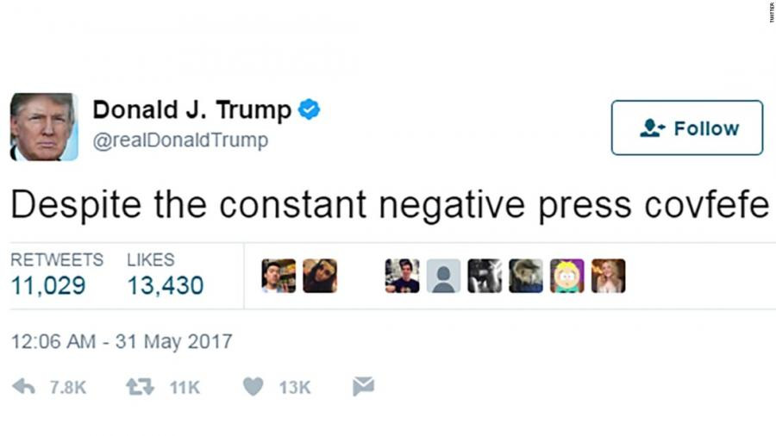
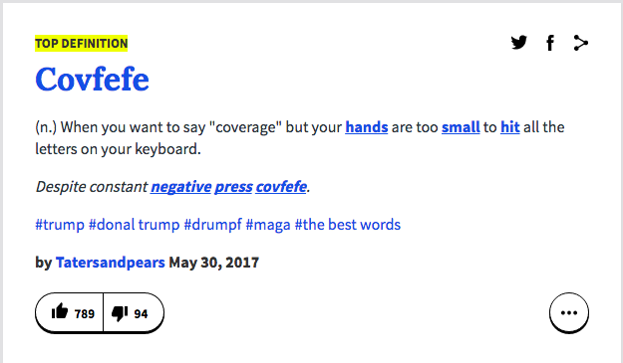

Slide 4
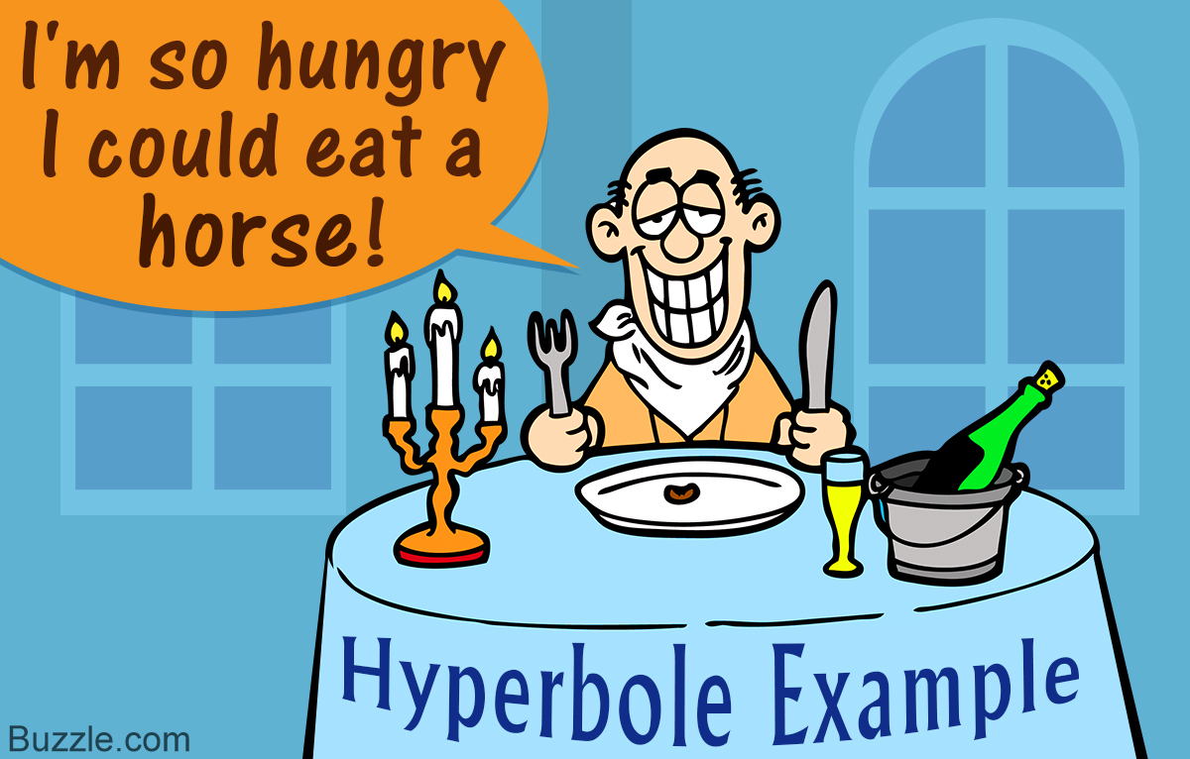

Slide 5
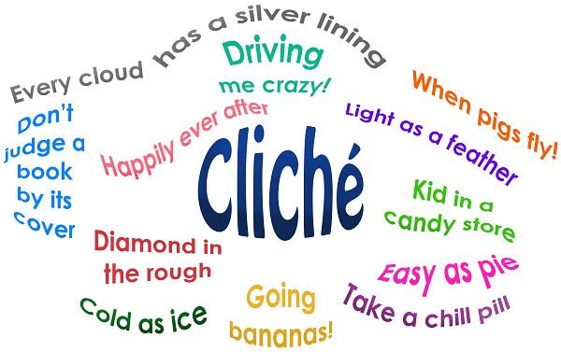

Slide 6
Vivid
Simile
Metaphor
Parallelism
Repetition
Alliteration
Antithesis
Notes:
http://www.history.com/topics/holidays/womens-history-month/videos/aint-i-a-woman

Slide 7
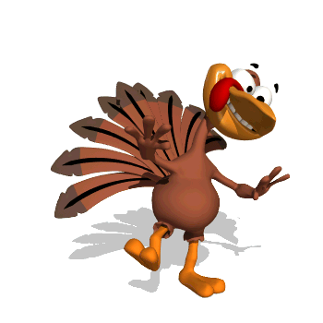

Slide 8
