Slide 1
Fundamentals of Speech
With Professor Collier
Listening

Slide 2
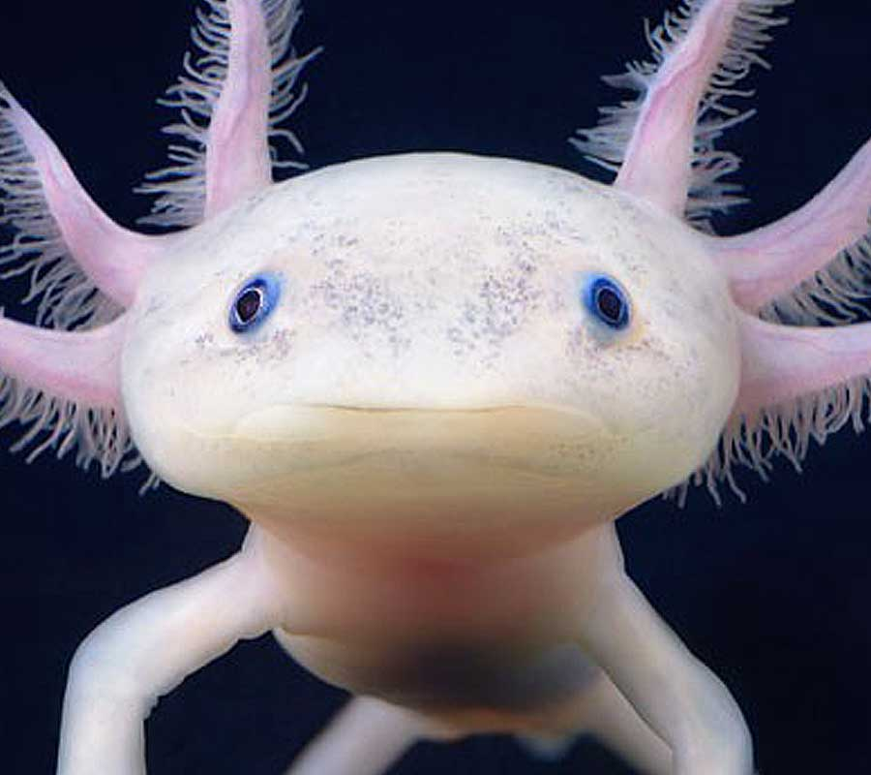
https://www.youtube.com/watch?v=Eo50ctoOTWs​

Slide 4
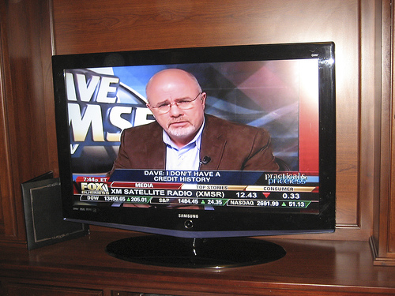
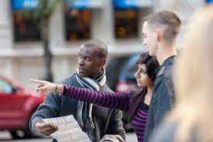
Types of Listening
Appreciative
Empathetic
Informational
Critical

Slide 5
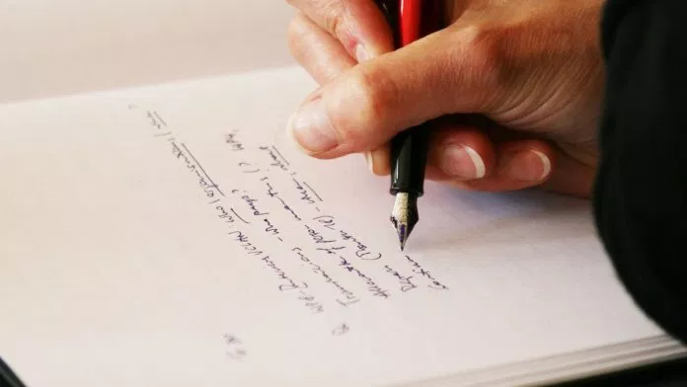
Barriers

