Slide 1
Fundamentals of Speech
With Professor Collier
Persuasion Speech Preparation

Slide 2
Deadlines:
11/9 – ALL OUTLINES
11/9 - 1. Angelica, 2. Jamilla , 3. Jessica 4. Katherine , 5. Tymea , 6. Kathleen , 7. Jazmeene Fox , 8.Marika, 9. Janely , 10. Sakeena , 11. Jazmine Furs, 12.Fabrice
11/16 - 1. Alexa , 2.Christal, 3. Kahera, 4. Jacinto , 5. Katelyn , 6.Shakira, 7. Enami , 8. Shaquille, 9.Teshaya, 10.Natalia, 11. Vinicio, 12.Adriana, 13. Kristelle, 14. Adona

Slide 3
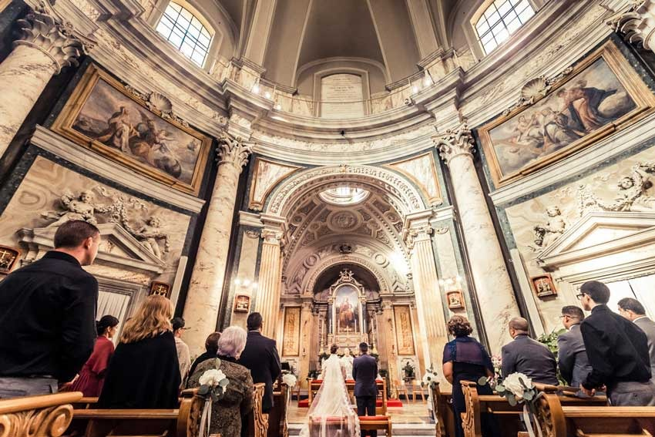
Speech Topics

Slide 4
Visual Aid Requirements
4-6 Slides
IMAGES ONLY
Pop-ups are allowed
No videos, but you can use GIFs
Sound effects are allowed
Have two ways to access this
Due on the day of YOUR speech

Slide 5
Oral Citation
According to…
Source + date
Summarize info

Slide 6
Psychology Test

Slide 8
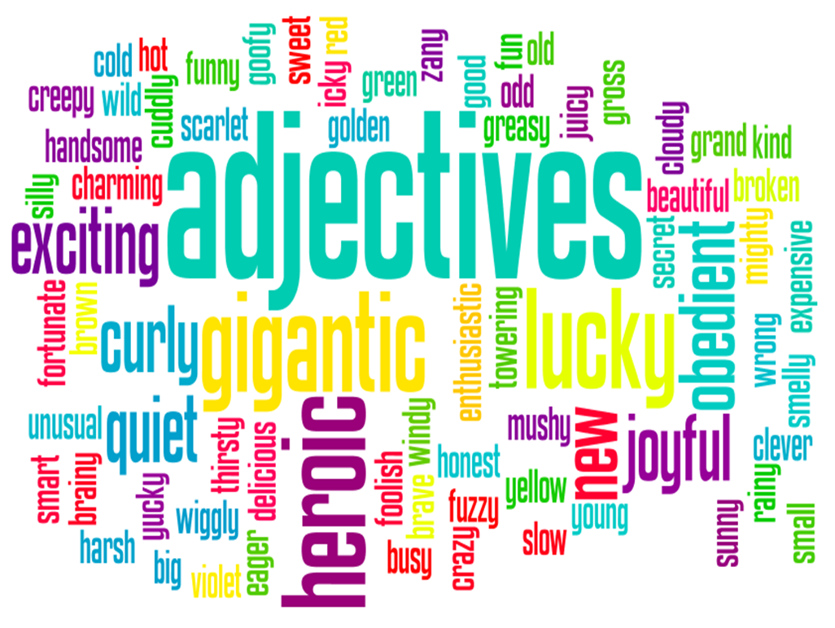

Slide 13
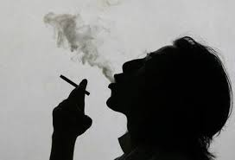
Notes:
Use Presentation Aids Effectively

Slide 14
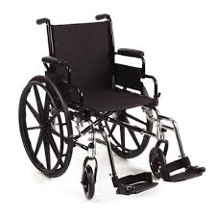
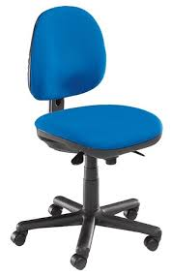
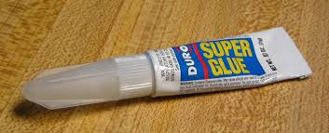

Slide 15
Q&A

