Slide 1
Basic Speech
With Professor Collier
Speaking on Special Occasions

Slide 2
Impromptu Speaking

Slide 3
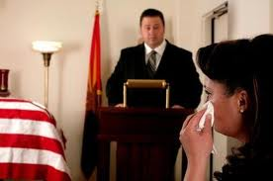
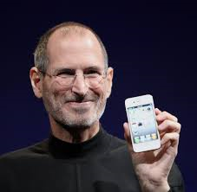
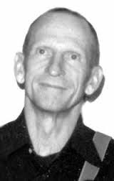
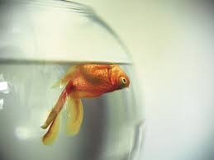
https://www.youtube.com/watch?v=P5pBN3cE-2A
Eulogy

Slide 4
Eulogy
How do you know the person who died?
How did he or she die?
What did the person accomplish in his or her life?
How will this person be remembered?
Who will miss this person?

Slide 5
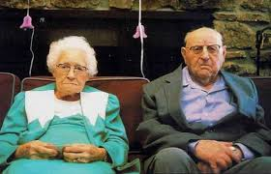
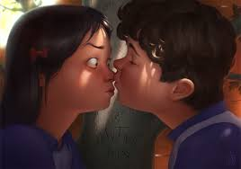
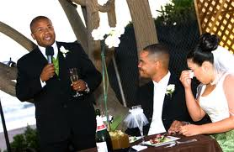
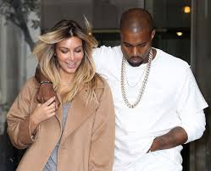
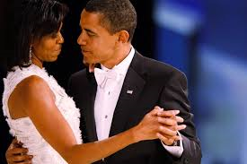
https://www.youtube.com/watch?v=S6GPicVYCvs

Slide 6
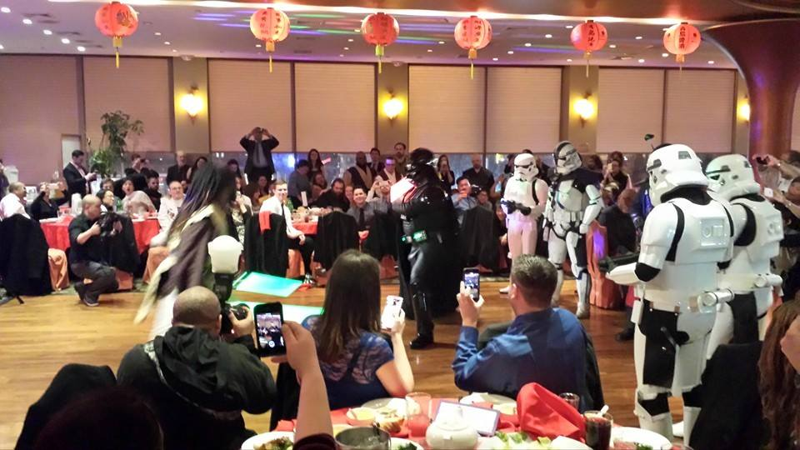
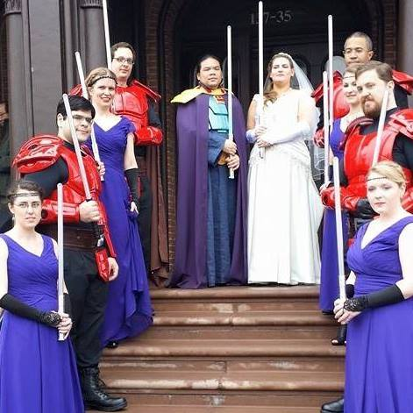
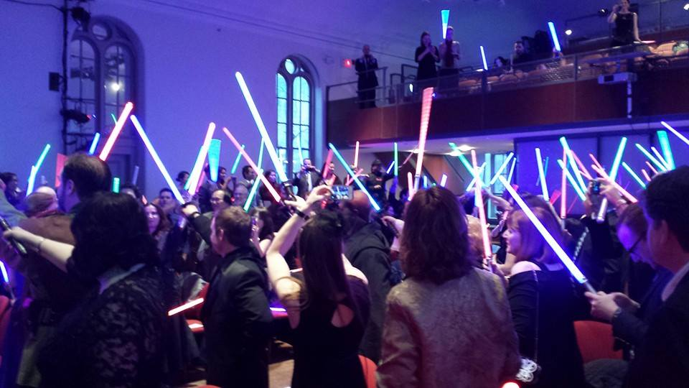
The Wedding of Jenn & Alex

Slide 7
Wedding Toast
How do you know the bride/groom?
Funny Story, or challenges the couple overcame together.
Why is this going to be a good marriage?
What do you wish for your future?
Finish with – “to the bride and groom.”

Slide 8
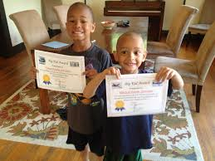
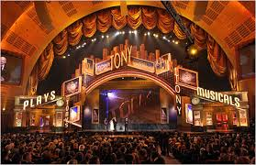
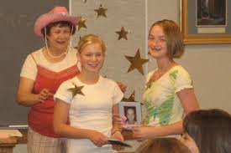
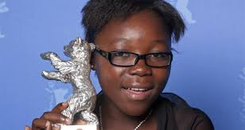
http://www.youtube.com/watch?v=ImoMGyJjWIk
https://www.youtube.com/watch?v=oFSY4Mda_18

Slide 9
Award Presentation
What is the award?
Who are you giving it to?
Why do they deserve this award? Give extended examples.

Slide 10
Award Acceptance
Express Thanks & Honor
Challenges/Heights
Who helped you along the way, and how did they help you?

Slide 11
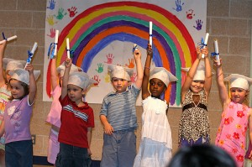
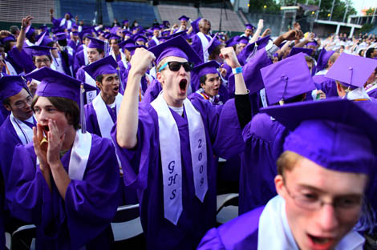
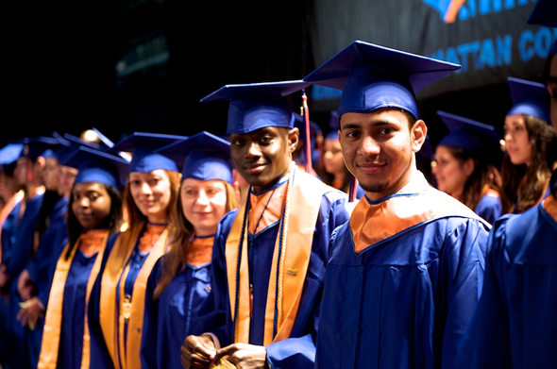
https://www.youtube.com/watch?v=eyvDW1rinfs

Slide 12
Commencement
What have the students accomplished?
Who helped them get there?
What advice will you give them for the future?
To the ________ class of 2016 – (some kind of cheer/wish)

Slide 13
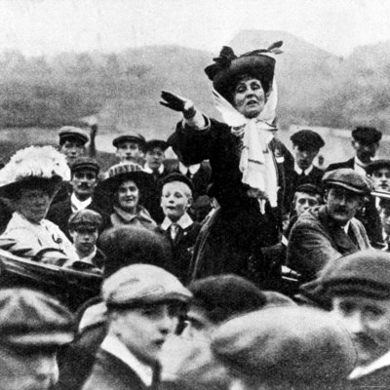
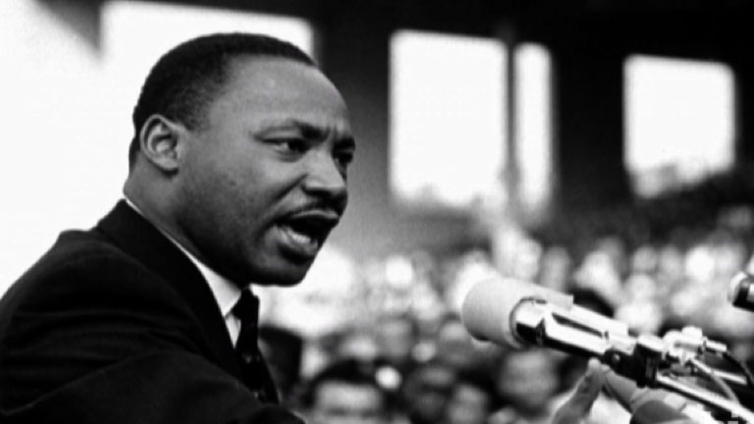
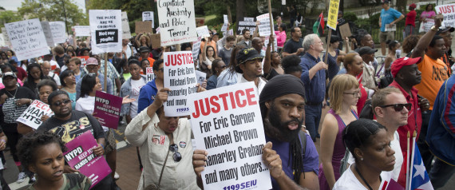
https://www.youtube.com/watch?v=1vY7HjZ-VMs

Slide 14
Activist
Catch our attention
Outline the cause & why it needs support
Issue a “call to action”

Slide 15
Special Occasion Speeches

Slide 17
Special Occasion Speeches
Categories are randomly decided
You choose the occasion
You decide on the audience
1-2 minutes in length
No notes allowed
No outline required
Practice at home with a timer
Props for Wedding/Award

